Slide 1


Dec 2020 STAAR EOC
Test Administrator Training
Insert Campus Name

Slide 2
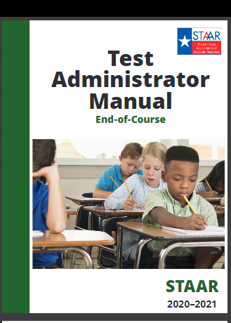
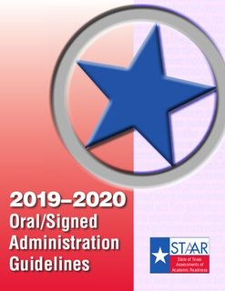
This training session DOES NOT eliminate your requirement to read the appropriate Test Administrator Manuals.
**Note to CTC, this image does not reflect the 2020-2021 OA guidelines. The latest version is expected to be released soon.
**Note to CTC, in addition to your manuals, it is recommended that you create packets with testing rooms and locations, small group information etc.
Each test administrator needs an EOC test administrator manual.
If you will administer an oral administration site, ensure you have received a copy of the Oral Administration Guidelines in addition to your EOC test administrator manual.
You must read and familiarize yourself with the manuals. Failure to do so could result in an irregularity

Slide 3
Notes to CTC (for CTC use only-slide should be deleted)
Make sure you have a sign-in sheet that participants can sign to verify attendance. If the campus is training personnel virtually, ensure that you have created an electronic sign-in for documentation purposes.
Make sure you have provided copies of the Oral Administration Guidelines for those testing in OA testing sites.
Make sure you have provided copies of the Test Administrator manual for those testing.
Make sure you have provided copies of the STATE oath https://txassessmentdocs.atlassian.net/wiki/spaces/ODCCM/pages/392921127/Security+Oath+General?preview=/392921127/993493427/General%20Oath_Fall%202020%20(1).pdf
Make sure you have campus test administrator packet (Note to CTC, this is a campus decision to give and use, however it is recommended that you create packets with testing rooms and locations, small group information etc.-a sample may be found on our website.)

Slide 4
Campus Specific Information

Slide 5
Campus Specific Information: Test Schedule
Date | Assessment Given
12-7-20 (Monday) | No testing per state
12-8-20 (Tuesday) | English I Algebra, Biology, US History window
12-9-20 (Wednesday) | Algebra, Biology, US History window
12-10-20 (Thursday) | English II Algebra, Biology, US History window
12-11-20 (Friday) | All paper and writing online make-up sessions must be completed by the end of the day.
12-18-20 (Friday) | Last day to complete EOC online make-ups
**Note to CTC- edit and adjust these slides to reflect campus information that your test administrators need to be aware of to ensure your testing day flows smoothly.

Slide 6
Campus Specific Information: Test Administrators Pre-Prep Procedures
Be sure your room is ready for testing.
Cover or remove any instructional displays that may aid students (any instructional content regardless of subject). Only motivation posters can be left uncovered.
Read and highlight the directions you will be giving in advance.
Have extra pencils available.
Based on dictionary policy, make sure you have dictionaries available at a 1/5 ratio. These may be used for all portions of the test on all reading and writing assessments.
Based on calculator policy, make sure you have calculators available for Algebra I and Biology.
For online testing, make sure there is one pair of headphones per student.
For online testing, ensure students have the most updated STAAR app on their device.
Ensure you are familiar with test rosters and student accommodations.

Slide 7
Campus Specific Information: Test Administrators Pre-Prep Procedures Continued
For paper test administrations: Test administrators must verify roster, number of books, and answer sheets received.
For online only test administrations: During materials distribution, test administrators should confirm they have a test ticket for each student listed on their testing roster. Once verified, you must sign the materials control form.
Once you sign for test materials, it is your responsibility to maintain their security the entire time they are in your possession.
Return all test materials to the testing center at the completion of testing.
Test Coordinator will verify all test materials has been returned and online tests have been submitted. TC will sign in materials on the materials control form.
**Note to CTC- edit and adjust these slides to reflect campus information such as pick up time and location.

Slide 8
Campus Specific Information: Test Monitor/Test Reliever Information
MONITORS
Students must be supervised by an authorized person at all times.
Always make sure restroom stations are covered. Students must be supervised if they take a restroom break. Only one student at a time in the restroom unless you step in the restroom.
If you notice instructional material posted inside or outside of classroom, please remove and/or let test administrator know.
Please let other monitors know if you are leaving the testing area.
TEST RELIEVER
Make sure you sign in and out when you relieve a teacher. First and last name must be included—no initials!
Make sure you actively monitor students while in testing site.
If a student has to be moved, make sure they do NOT carry their test material.
Students must be supervised by an authorized person at all times.
Students may use highlighters to emphasize important information on a subject-area test. (Students should not get any marking on the black ticking lines.)
If you notice instructional material posted inside or outside of classroom, please remove and/or let test administrator know.
Review testing locations so that you can assist students in getting to their test sites.
Do not leave the testing area for prolonged periods of time.
Relieve test administrators for breaks as needed.
Pay attention to the classrooms you are assigned.

Slide 9
Campus Specific Information: Test Overview
Time | Task
8:00-8:30 | Pick Up Testing Material
9:15-9:30 | Check attendance/review seating charts. Collect cell phones and read script Have students sign cell phone oath
9:30-9:45 | Pass out materials Begin reading directions
9:45-10:00 | All testing sites should be able to start no later than 9:15
 | Lunch
 | Approximate test start time
All students will report to their testing site. Please review small group information with your students prior to testing.
Be at your testing location before the students arrive.
Complete the seating chart once you have verified students are in the correct location.
Collect cell phones and have student backpacks placed at the front of the room. Read cell phone script.
No personal belongings/books/papers/etc. on student desks.
Cell phones should not be returned until all testing is complete.
Computers not used for testing should be off. No electronic devices (teacher and student) should be visible during testing.
Take attendance using the absentee form provided.
All doors should remain open during testing.
SAMPLE, TC should edit

Slide 10
Campus Specific Information: Lunch Procedures
Time | Task
A Lunch 11:-11:35 | 12th graders
B Lunch 11:40-12:00 | 9th graders testing. A monitor will notify your class when to come to the cafeteria. Do not come early
C Lunch 12:00-12:20 | 10th and 11th graders testing. A monitor will notify your class when to come to the cafeteria. Do not come early
C Lunch 12:20-1:25 | 10th and 11th graders not testing
1:30 | All testing should resume
Lunch stop and start (resume) times must be recorded on the seating chart.
Make sure you collect test materials and store them in a locked location during lunch.
Students must be monitored at all times, even during lunch.
Make sure to record stop and start times for lunches when testing resumes.
SAMPLE, TC should edit

Slide 11

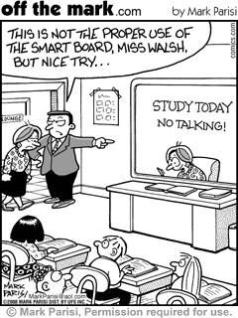
Questions

Slide 12
**Note to CTC- the next section of slides are a review of the manual. It is recommended that Test Administrators highlight and bookmark key parts. As CTC, you must read the manual prior to training to understand key parts for your training. Please note this is the manual for the entire year and will be used for Spring administrations. It is recommended to collect manuals after each testing administration.
STAAR Manual Review

Slide 13


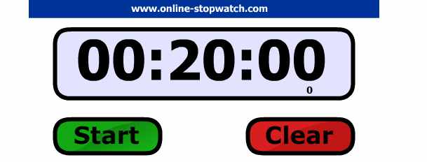

STAAR Manual Review: Time Limits
Manual pgs. 9-11
Unless they receive extra time as a designated support (these students may have extended time per their accommodations), students will have 5 hours to complete their English I and English II test and 4 hours to complete their Algebra, Biology and US History test.
Distribution of materials and the reading of test script directions are not included in the time limit. The time limit period will start after the test administrator has read directions and tells students to begin working on their test.
The start and stop times for the session and individual students must be completed on the seating chart.
You must record the lunch stop and start (resume) times for your testing class.
Communicate orally AND in writing, time remaining to test. Remind students all answers must be recorded within the allotted time period.
Make sure to collect test materials if a student leaves the room for any situation.
You should have 4 total times recorded on your seating chart.
Allowable Timers
Smart board with Online Stopwatch
General Timer
Not Allowed
The clock does not stop | The clock does stop
water breaks restroom breaks snack breaks short physical or mental breaks | lunch medical breaks emergency situations that significantly interrupt testing consolidation and movement of students to another testing area
Cell Phones

Slide 14
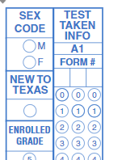
STAAR Manual Review: Student Data Collection
Manual pgs. 11
** Note to CTC, this is an optional slide. If you will not have your test administrators bubble anything for EOS, please delete.
New to Texas:
For all administrations (paper and online), districts should mark the “NEW TO TEXAS” field for any student who transferred into a Texas school or district from out-of-state during the current school year.
**Note to CTC, refer to PowerSchool Manual to run your EOS report. It is recommended if possible, to capture information prior to test day.
(Enrolled out of state)
https://www.dallasisd.org/cms/lib/TX01001475/Centricity/Domain/72/Test%20Coordinator%20Manual_8.6.20.pdf

Slide 15
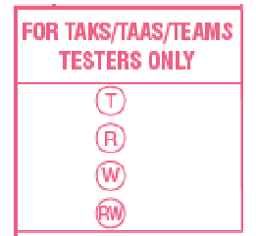
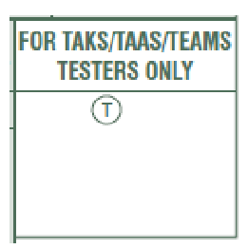
TAKS/TAAS/TEAMS Student Answer Sheets
Manual pgs. 12, 43-44
If a former TAKS, TAAS, or TEAMS examinee chooses to take a STAAR test to fulfill his or her assessment graduation requirements, then staff will need to mark the appropriate bubble on the STAAR answer document.
** Note to CTC, this is an optional slide. If you will not have your test administrators bubble anything for OOS, please delete.
**English I cannot be used as an alternate assessment.
For English II, mark
• “T” if an eligible examinee is taking this test as an alternate for TAKS ELA.
• “R” if an eligible examinee is taking only the reading section of this test as an alternate for TAAS or TEAMS reading.
• “W” if an eligible examinee is taking only the writing section of this test as an alternate for TAAS writing.
• “RW” if an eligible examinee is taking both the reading and writing sections of this test as an alternate for TAAS reading and writing.
For Algebra I mark
• “T” if an eligible examinee is taking this test as an alternate TAKS, TAAS, or TEAMS mathematics.
For Biology and U.S. History, mark
• “T” if an eligible examinee is taking this test as an alternate for TAKS science or social studies, respectively.

Slide 16
STAAR Manual Review: Accommodations-Accessibility Features
Manual pgs. 13-14
Your testing rosters will indicate which students are to receive accommodations. Before testing, if you are unclear of any accommodations, ask your CTC.
Certain accessibility features may be provided to students based on their needs; students can not be made to use them. Common Accessibility features include (see page 13/14 for full list):
allowing a student to use a bilingual dictionary (word-to-word translations; no definitions or examples) on mathematics, science, and social studies assessments
reading aloud or signing the expository or persuasive writing prompt to any student who requests this assistance
making assistive tools available such as various types of scratch paper, various types of highlighters, colored pencils, etc.
allowing individual and small-group administrations
reminding students to stay on task
the state-supplied mathematics graph paper

Slide 17
STAAR Manual Review: Accommodations- Designated Supports
Manual pgs. 15-17
Designated Supports: These are locally-approved supports for students who meet eligibility criteria. These supports are approved by committee decision and should not be given unless documented and predetermined by appropriate decision-making committee. The full list of designated supports is listed below:
  Basic Transcribing
  Braille/Refreshable Braille
  Calculation Aids
  Content and Language Supports
  Extra Time (Same Day)
  Individualized Structured Reminders
  Supplemental Aids
  Large Print
  Manipulating Test Materials
  Mathematics Manipulatives
  Oral/Signed Administration
  Spelling Assistance
  Supplemental Aids
  Designated Supports requiring TEA approval-Complex Transcribing, Extra Day, Math Scribe, Other

Slide 18
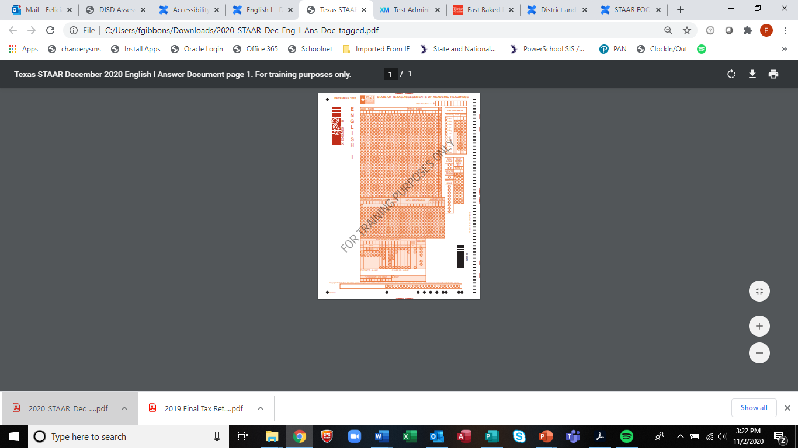
STAAR Manual Review: Accommodations-Designated Features > Basic Transcription
For a student who meets the eligibility requirement, this designated support allows a test administrator to transfer student responses onto an answer document or into the STAAR Assessment Management System for online administrations when a student is unable to accomplish this task independently.
Example/Type
The test administrator may carry out Basic Transcribing to transfer student responses onto the answer document or in the Texas Assessment Management System for online administrations in these situations only.
The student writes or circles responses in the test booklet for multiple-choice or griddable questions.
The student points to responses in the test booklet or on the computer screen for multiple-choice questions.
The student dictates or signs responses for multiple-choice and griddable questions.
The student writes responses on another workspace (e.g., scratch paper, dry erase board) or types responses on a word processor for multiple-choice questions, griddable questions, or the writing prompt.
The student uses speech-to-text technology to indicate responses for multiple-choice questions, griddable questions, or the writing prompt, including the use of the online embedded support on the STAAR online testing platform (SOTP).
The student dictates or signs information to be recorded in the margins of the test booklet or in the notes tool for online tests (does NOT apply to math calculations or responses to the written composition).
The person who completed basic transcription should write “Transcribed by (name) due to (reason)
Example:
Transcribed by John Jones due to basic transcription support
Transcribed by Doe Will due to student broken hand.

Slide 19
STAAR Manual Review: Accommodations-Designated Features > Extra Time
For students who meet the eligibility requirements for this designated support, please note the following:
  Students should be allowed to continue until the regularly scheduled school day ends but cannot be required to continue testing until that time.
  A student who receives extra time to complete his or her test may be transferred to a different location after the original testing session has ended. Testing personnel must be made aware of the monitoring requirement when students are transferred from one area to another. Students are not permitted to transport test materials outside the testing environment.
  IMPORTANT: Extra time testing sessions should start at the beginning of the school day and may go until the end of the regularly scheduled school day for all subjects. Extra time testing sessions must NOT extend beyond a typical seven-hour school day for any one student.

Slide 20
STAAR Manual Review: Accommodations-Designated Features > Oral Administration
Manual pg. 17
For a student who meets the eligibility requirement, Oral Administration is a designated support in which test questions and answer choices are read aloud or signed to a student. For students taking STAAR online, OA is delivered using text-to-speech functionality.
**Note to CTC, this image does not reflect the 2020-2021 OA guidelines. The latest version is expected to be released soon, therefore picture nor link is updated
There is a separate guidelines manual for this! Please raise your hand if you will administer an oral administration test session and did not receive the OA guidleines manual. Test Administrators administering OA sessions must:
review and be trained in the procedures specific to an oral administration based on the Oral/Signed Administration Guidelines prior to administering assessment.
be familiar with what is and is not allowable to be read during Oral Administration for each different subject.
complete the OA portion of the oath.
Oral Administration Guidelines Link

Slide 21
STAAR Manual Review: Accommodations-Designated Features > Oral Administration
Test Administrators administering an oral administration site must have a book with the same form number as student test books for themselves and their students. Ex: Test administrator A has OA testing site with 11 students. Therefore 12 books are needed: 11 for students, 1 for TA. All books should have same form number.
When you check out your materials, please verify that the books you received are the same form. If not, please notify your campus test coordinator during the check out process.
Oral Administration Guidelines Link: will be updated as soon as the current version is posted by TEA.

Slide 22


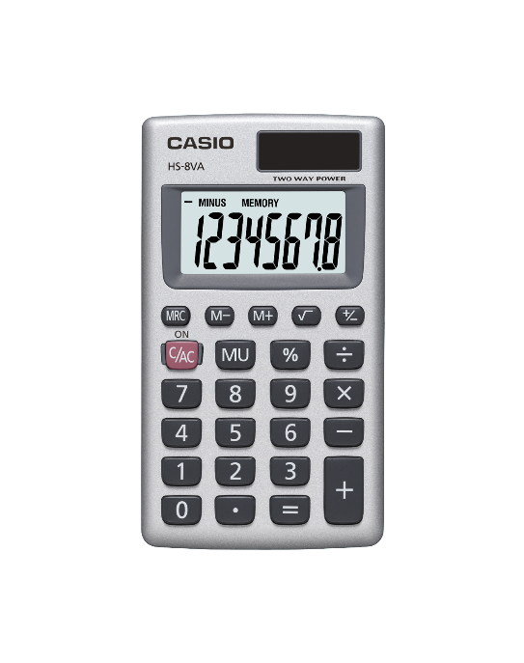



Dictionary Policy Link
Calculator Policy Link
The link for the full calculator policy is above.
To disable certain features on the TI Nspire Graphing Calculators, the STEM department created a video on how to disable certain the features https://drive.google.com/file/d/1urVDIfbmktSS5ItwKFdwMkxYgBP4Ny-C/view?ts=5e5d8e78
This is the STAAR version of Desmos. https://www.desmos.com/testing/texas/graphing. This is different from the online version as the certain features have been turned off for testing.
Calculation devices that have a computer algebra system (CAS) are not allowed unless the CAS is disabled. Calculation applications on smartphones are also not allowed.
If campuses need further information, contact the STEM department.
Inventory calculators ASAP
Campuses must ensure that dictionaries are available to all students taking:
  STAAR EOC English I, English II
  Use a 1:5 student ratio
The following types of dictionaries are allowable:
standard monolingual dictionaries in English or the language most appropriate for the student
dictionary/thesaurus combinations
bilingual dictionaries*
English as a second language (ESL) dictionaries* (define English word using simplified English)
sign language dictionaries
picture dictionaries
Both paper and electronic dictionaries are permitted. However, electronic dictionaries that provide access to the Internet or have photographic capabilities are NOT allowed.

Slide 23
STAAR Manual Review: Test Security-Maintaining Security of Test Materials
Manual pg. 19
No person may view, reveal, or discuss the contents of a test booklet or online assessment before, during, or after a test administration unless specifically authorized to do so by the procedures outlined in the test administration materials.
No person may duplicate, print, record, write notes about, or capture (electronically or by any other means) any portion of a secure assessment instrument (paper or online) without prior approval from TEA. Districts may not duplicate and retain student compositions.
Only students may respond to test questions, perform calculations, and create rough drafts to written responses.
Test administrators who have permission to view secure materials in order to provide an approved accommodation or as part of the program-specific test administration process must be reminded that they are viewing secure content and that responding to test questions, recording the information they see, scoring the test, or discussing the content of the test at any time is strictly prohibited.
No person may review or discuss student responses or solicit information from students about secure test content during or after a test administration unless specifically authorized to do so by the procedures outlined in the test administration manuals.
**Note to CTC- the next section of slides discuss test security violations, both procedural and serious. Please be sure to emphasize the ones that have occurred before on your campus. Please also emphasize that not completing the seating chart in its entirety, both part I and II, is considered an irregularity.

Slide 24
STAAR Manual Review: Test Security-Technology Used During Assessments
Manual pg. 20-21
Test administrators must actively monitor the use of the technology, including technology-based accommodations, during an assessment. For a device or software to be considered appropriate for state assessment use, it must:
be set in a mode that locks the user into a specific software program;
block the user from accessing functionality that may violate test security, such as
  The ability to send secure test content (e.g., messages, captured images, videos);
  the ability to send or receive any person-to-person communication about secure test content (e.g., chat, video); and
  the ability to save secure test content.
When using applications on a tablet, laptop, or desktop computer, districts must ensure the application does not provide functionality that compromises the content being assessed.

Slide 25
STAAR Manual Review: Test Security-Serious Irregularities
Manual pg. 21-22
  Serious Irregularities can result in the individual(s) responsible being referred to the TEA Educator Certification and Standards Division for consideration of disciplinary action. Conduct that constitutes a serious testing irregularity may include, but is not limited to, the following:
      directly OR indirectly assisting students with responses to test questions
      tampering with student responses
      viewing secure test content before, during, or after an assessment unless specifically authorized to do so
      discussing or disclosing secure test content or student responses
      scoring students’ tests, either formally or informally
      duplicating, recording, or electronically capturing confidential test content unless specifically authorized to do so
      failing to report to an appropriate authority that an individual engaged in any of the events listed previously or in any other serious violation of security and confidentiality

Slide 26
STAAR Manual Review: Test Security-Procedural Irregularities
Manual pg. 21-25
  Procedural irregularities are less severe, more common, and typically the result of minor deviations in testing procedures. Some examples of procedural irregularities include:
      Monitoring errors
      Eligibility errors
      Accommodation errors
      Improper accounting for secure materials
      Failure to read script verbatim
      Duplicating, recording, or electronically capturing confidential test content unless specifically authorized to do so
      Student permitted to test beyond allocated time
      Student issued test material or test tickets belonging to another student

Slide 27
STAAR Manual Review: Test Security-Effective Monitoring
Manual pgs. 21-25
A trained test administrator must be present in each testing room at all times during testing. There must be at least one test administrator for every 30 students.
Never leave test materials unsupervised.
Move around the classroom and constantly observe the students.
Ensure students understand there is not free time if they finish early. They may read a book or put their head down.
Maintain a QUIET testing environment the entire time (even if your class is finished).
Follow required accommodations/designated supports.
Verbal/written reminders of time remaining to ensure student has time to record answers or answer sheet.
Check that students have appropriate answer sheet and test booklet.
As soon as a student finishes testing, inspect answer document and if student did not bubble all answers say, “You have not recorded all of your answers on the answer document, please do so now.”
Ensure that the tests of students testing online have been submitted prior to the student exiting the SOTP.
Check for cell phones and electronic devices.
***Staff Members SHOULD NOT be on electronic devices as well.

Slide 28
All Irregularities should be reported to your campus TC immediately, do not wait until testing is over.

Slide 29
STAAR Manual Review: Test Security and Confidentiality-Penalties for Violation of Security
Manual pg. 26-27
As indicated in TAC, §249.15, any person who violates, assists in the violation of, or solicits another to violate or assist in the violation of test security or confidentiality, as well as any person who fails to report such a violation or fails to cooperate with a TEA investigation, is subject to the following penalties:
placement of restrictions on the issuance, renewal, or holding of a certificate, either indefinitely or for a set term;
issuance of an inscribed or non-inscribed reprimand;
suspension of a certificate for a set term or issuance of a probated suspension for a set term; or
revocation or cancellation, which includes accepting the surrender of, a certificate without opportunity for reapplication for a set term or permanently; or
imposition of any additional conditions or restrictions upon a certificate that the SBEC deems necessary to facilitate the rehabilitation and professional development of the educator or to protect students, parents of students, school personnel, or school officials.
As stated in the TEC, §39.0303, Secure Assessment Instruments, Criminal Penalty, A person commits an offense if:
the person intentionally discloses the contents of any portion of a secure assessment instrument developed or administered under this subchapter, including the answer to any item in the assessment instrument; and
the disclosure affects or is likely to affect the individual performance of one or more students on the assessment instrument.
An offense under this section is a Class C misdemeanor.

Slide 30
STAAR Manual Review: Online Testing
Manual pg. 30-32
Preparing for Online Testing
Be prepared to aid your campus coordinator in preparing materials for testing if you are asked to do so.
Ensure that students have reviewed the student tutorial for the online testing system. A web-based tutorial is available at: https://tx-tss.caltesting.org/inbrowser/
Campus coordinators must generate and print student test tickets at least one day before the test administration.
-Student test tickets contain the unique username, password, and Session ID needed to log in to take the test, and, if applicable, information about embedded supports.
Student test tickets must be stored in a secure location prior to the test administration.
It is imperative to ensure students receive their correct ticket. Be sure to have students review name and grade to ensure incorrect tickets are not given to students.
**Note to CTC, Information on printing student test tickets can be found on our website under the Assessment Tab>STAAR>Navigating the ETS Online System for STAAR Testing

Slide 31
STAAR Manual Review: Test Security-Seating Charts
Manual pg. 30 & 34
Seating Chart Reminders:
Complete ALL parts of the seating charts.
The top heading of each page MUST be filled out in its entirety.
Complete ALL student columns.
Complete the blank diagram on page 2.
Only include students who were present and tested in your classroom.
Make sure to include start and stop times.
When writing book numbers, please note that each test booklet contains a 10-digit security number printed on the back of each booklet. Ignore the letter “S” before the number.
Seating Chart Must Include the Following:
Campus Name and TEA #
Room number, date
Complete name of test administrator(s)and signatures
Test taken subject area, grade level (if required)
Testing start and stop time(s) including lunch times, if applicable
Complete name of each student testing, student ID number
Booklet number and form number, as applicable
Complete name of relief personnel
**Every class must submit a seating chart for each day of testing using the DISD General Seating Chart. Failure to complete ALL portions of the seating chart is considered an irregularity.

Slide 32
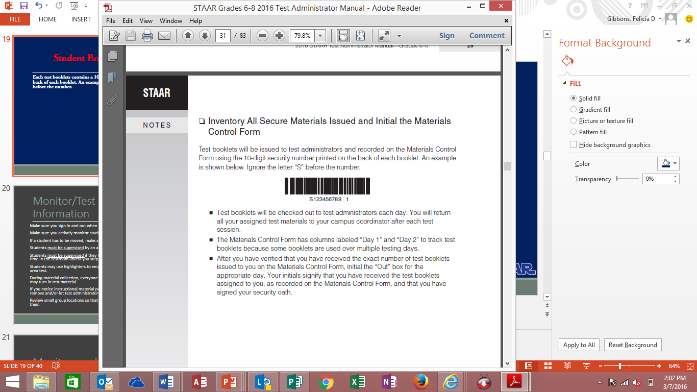
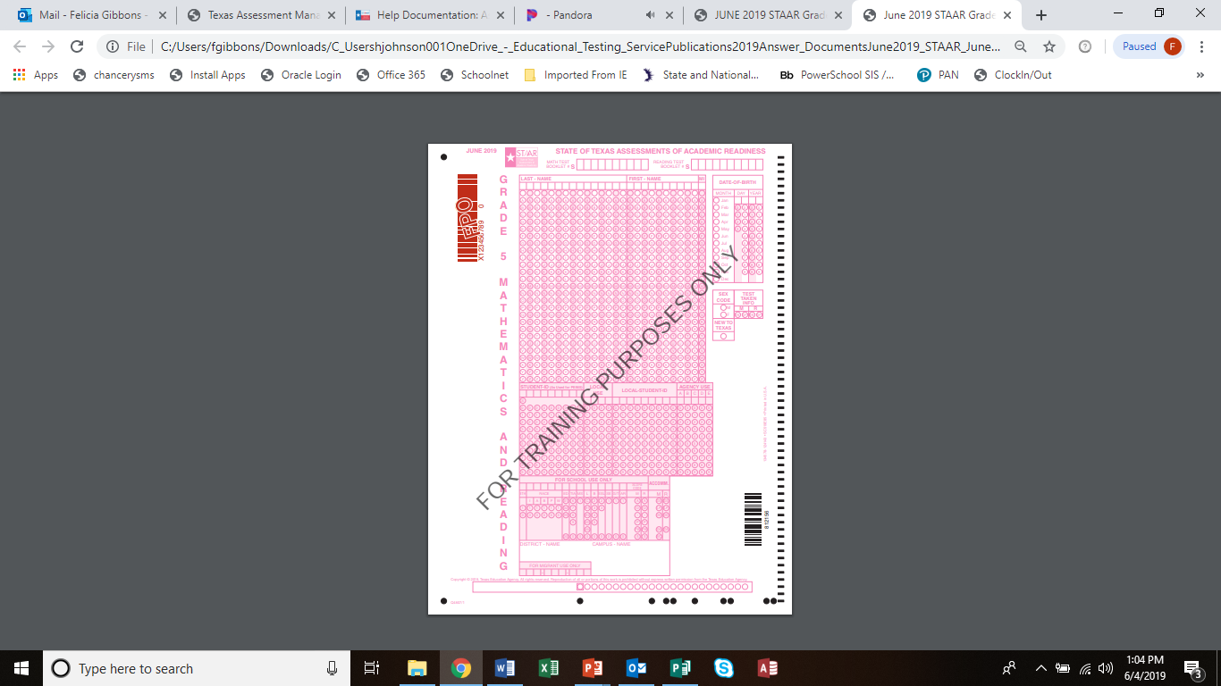
STAAR Manual Review: Test Security-Student Book Numbers
Manual pg. 30 & 34
Student Book Number Reminders:
When writing book numbers, please note that each test booklet contains a 10-digit security number printed on the back of each booklet. Ignore the letter “S” before the number.
1) The “S” should not be included only the ten digits after
2) One number per box
1 | 2 | 3 | 4 | 5 | 6 | 7 | 8 | 9 | 1
**Note to CTC, during this slide it is recommended that you go over the DISD General Seating Charts. As a reminder, someone will check your seating charts during the quality control process. Seating charts have been revised and may be found on the assessment website under the test security tab.
It is recommended to give this slide as a handout in your test booklets or have Test Administrators write example on board to help students correctly write their book numbers at the top of their answer sheet
**Every class must submit a seating chart for each day of testing using the DISD General Seating Chart. Failure to complete ALL portions of the seating chart is considered an irregularity.

Slide 33
STAAR Manual Review: English I and II Writing Assessments
Manual pg. 38
Ensure the procedures below are followed during the English I and English II assessments.
  The test administrator may read aloud or sign the expository or persuasive writing prompt to any student who requests this assistance.
  Reading or discussing student compositions is not allowed at any time.
  Reading selections may not be read aloud to a student.
  At no time before, during, or after the administration of the assessment are test administrators and other campus personnel permitted to assist students with their written compositions.
  The test administrator must NOT do the following:
    elaborate on the prompt
    give students an opening and/or closing sentence
    give students an outline for organizing their composition
    give students ideas about how to develop their composition
    translate the prompt into another language (except sign language)
    read aloud the analytical selection or analytical writing prompt

Slide 34
STAAR Manual Review: Students Who Become Sick During a Test
**Note to CTC- this is found in DCCR, manual only mentions this as it relates to online testing
Manual pg. 43
Make-up testing may also be used for a student who becomes sick and leaves campus during the test. If the student has not completed the assessment, he or she may complete the test within the scheduled administration dates. Test administrators should keep track of the amount of time a student used on the first day so that the student is provided the remaining test time to complete the test on the make-up day.
Test administrators should use a paperclip to separate the questions the student has completed on the first day, so the student does not go back to those questions on the make-up day. This applies to
  grades 3–8 mathematics
  grades 5 and 8 science
  grade 8 social studies
  Algebra I, Algebra II, Biology, and U.S. History
Test administrators should use a paperclip to separate the passages and related questions that a student has completed on the first day, so the student does not go back to those passages and related questions on the make-up day. This applies to
  grades 3–8 reading
  grades 4 and 7 writing
  English I, English II, and English III
For online administrations, students testing over multiple days are able to view all items and passages but will not be able to edit responses completed on a previous day. Students actively testing at 11:59 PM (CST) will not have their answers locked until the student logs out of the test or has been automatically logged out by the application due to inactivity.

Slide 35
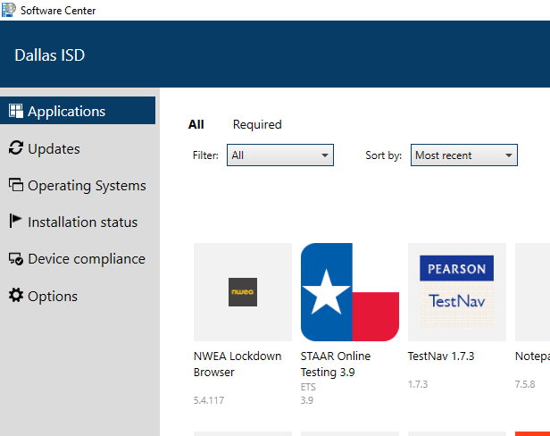
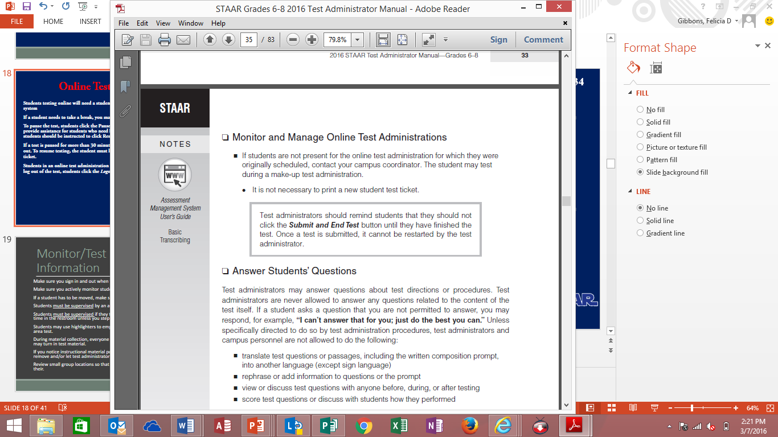
STAAR Manual Review: Online Testing
Manual pgs. 43-45
Online Tools Appendix B
Students testing online will need a student test ticket to log in to the ETS system.
If a student needs to take a break, you may pause the test.
To pause the test, students click the Pause button. The test administrator should provide assistance for students who need help pausing their tests. To resume a test, students should be instructed to click Resume on the Pause screen.
If a test is paused for more than 30 minutes the student will automatically be logged out. To resume testing, the student must log back in using the original student test ticket.
Students in an online test administration should log out if they take a lunch break. To log out of the test, students click the Logout button.
Ensure students have properly exited test BEFORE allowing them to leave test session.
Students who cannot finish their tests due to illness or a testing irregularity should not click the Submit and End Test button. The student should log out of the test. **Please notify TC in this instance for additional guidance.
Make sure you are launching tests using the STAAR app. The most current version is located in the DISD software center.
**Report any online issues IMMEDIATELY to campus test coordinator .

Slide 36
STAAR Manual Review: Administration Directions
Paper Administration Directions: begin on page 51 of your manual. It is important to read and highlight your directions in advance.
Online Administration Directions: begin on page 63 of your manual. It is important to read and highlight your directions in advance.
Remember, this training does not take the place of reading your manual.

Slide 37

Questions

Slide 38
Student Answer Sheets
**Note to CTC- while reviewing this section, make sure to emphasize the difference in precoded and hand gridded answer documents to ensure students do not bubble on documents that are already precoded.

Slide 39
Student Answer Sheets
Test Booklet Number:
**Students should complete based on the number located on their student booklet.
Form #, written AND bubbled
New to Texas Indicator
Precoded Answer Documents will include a small imprint in this area. Do NOT hand-grid answer documents with precoded information unless the precoded information is incorrect.
All student information and program information hand-gridded on the answer documents must be completed using only a No. 2 pencil.
Precoded Answer Documents imprint area
Score Code
A= absent
O= other
S= Score
Score Code Field indicates whether a student’s test should be scored
Failure to grid correctly may result in a score of zero.
Student Accommodation Field
The following accommodation bubbles may be available, depending on the test and/or the mode of testing.
  DS = Designated Support
  LP = large print
  XD = extra day (requires TEA approval)
  OA = Oral Administration
  EE = Spelling Assistance
If Answer Document is a hand-grid, please write District and Campus Name in this area.

Slide 40
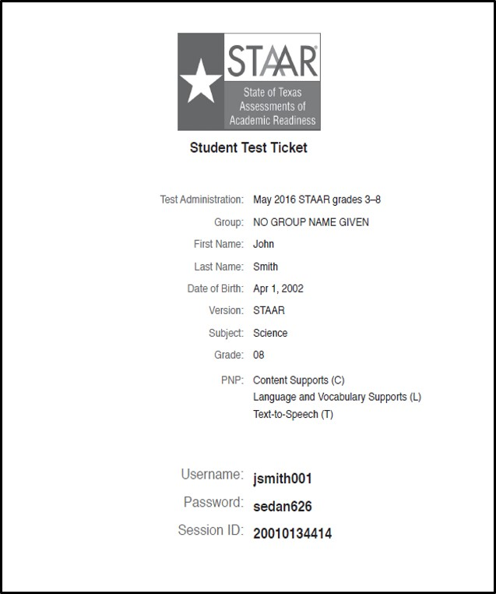
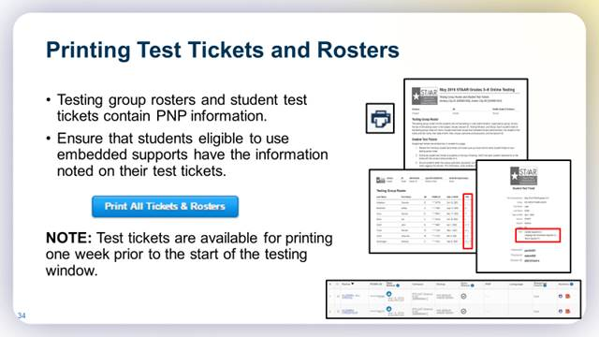
Student Test Tickets
Test administration information
Student Information:
Student First/Last Name
Date of Birth
Test Version
Subject
Grade Level (when applicable)
PNPs assigned to the student
Student log-in information

Slide 41
Additional Sample STAAR Answer Sheets for Training Purposes
https://txassessmentdocs.atlassian.net/wiki/spaces/ODCCM/pages/377487476/2020+December+Answer+Documents
** Note to CTC- A sample of each grade/subject answer sheet may be found on the website link listed below. It is recommended that you give test administrators a copy of a sample answer sheet for their grade indicating what areas should be completed prior to turning in to you at the conclusion of testing each day.

Slide 42
The following items should be returned to your campus TC:
Testing Roster
Testing tickets (online test only—ensure tests have been submitted)
Ensure Answer Document Fields have been completed
Seating Charts with Part I and II completed
Manual
Student Answer Sheets (do not place inside of books)
Student Test Booklets in Numerical Order
Scratch Paper
Pencils
Supplemental Aids –if used

Slide 43
Final Overview
Distribute materials and give directions as described in your manual. Do not deviate from the directions. You will say what appears in bold print. You may repeat directions as many times as needed.
Paper testers: Verify that students have put their 10-digit test booklet number on their answer document. Students should not put the “S”. Verify that students have entered the form number on the answer document.
Paper testers: Verify that students have written their name on their test booklet.
Students should use No. 2 pencils, not mechanical pencils.
Online testers: Ensure that the student submits the test before exiting the SOTP.
Students should sit quietly when finished or put their head down. DO NOT ALLOW STUDENTS TO SIT WITH MATERIAL ON DESK WHEN THEY ARE FINISHED.
Actively monitor at all times.
All testing irregularities will be reported to the Dallas ISD Office of Test Security.
Once students are finished, collect their book and answer sheet in separate stacks. DO NOT ALLOW STUDENTS TO PLACE ANSWER SHEET INSIDE OF BOOK AS THEY TURN MATERIAL IN TO YOU.
Ensure the following is marked on answer sheet IN PENCIL:
        Test taken information and form number
        New to Texas (if applicable)
        Score Code
        Accommodations (if applicable)
        Test Date

Slide 44
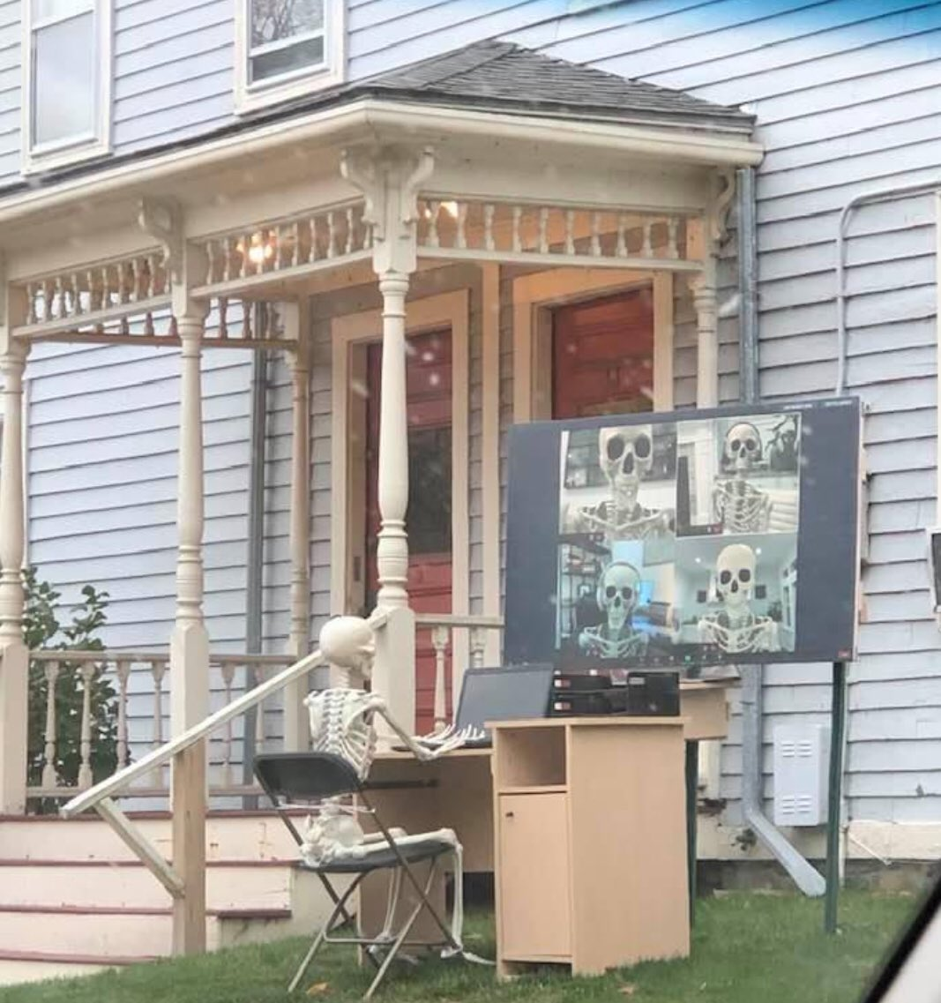
Questions

Slide 45
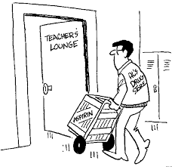
Know your Responsibilities
Remember…this training does not take the place of reading the manual. There is no substitute for reading the manual.
If you have questions, please contact your test coordinator immediately. Remember, do not wait until the end of testing to ask a question that may impact the assessment. I am here to help!!
Test Coordinators at the end of EOC and ACP testing
Thank you for your time and attention! A copy of this PowerPoint will be emailed to you for your review. Please complete your oath and turn in to campus TC.

Slide 46
** Note to CTC- it is required that after your group training, you go over the OA guidelines with those test administrators who will administer oral administration to ensure they understand books with the same form number are needed for the students AND themselves. Be sure they understand what can and cannot be read as per the guidelines outlined in the OA guideline manual.

