Slide 1
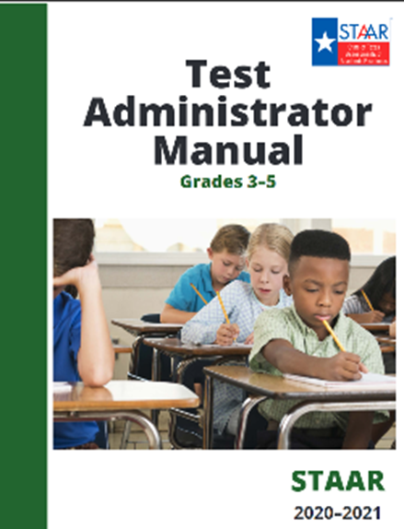
Elementary Campus Test Administrator Training
Spring 2021 Administrations
April: Grade 4 Writing
May: Grades 3-5 Math & Reading; Grade 5 Science

Slide 2

This training session DOES NOT eliminate your requirement to read the appropriate Test Administrator manuals.
Make sure you have signed in on the training sign in sheet.
Make sure you have submitted your oath upon completion of training.
Make sure you have a test administrator packet or monitor packet based on your assigned role (Note to CTC, this is a campus decision to give and use, however, it is recommended that you create packets with testing rooms and locations, small group information etc.)
If you are a test administrator, ensure you have received your STAAR manual.
If you will administer an oral administration group, ensure you have also received a copy of the Oral/Signed Administration Guidelines.
You must read and familiarize yourself with the manuals. Failure to do so could result in an irregularity.

Slide 3

Campus
Specific Information
**Note to CTC- edit and adjust these slides to reflect campus information that your test administrators need to be aware of to ensure your testing day flows smoothly

Slide 4
Campus Testing Schedule
Grade 4 Writing |  | Grades 3-5 Math |  | Grades 3-5 Reading |  | Grade 5 Science
Paper April 6 (Tue) | Online April 6 (Tue) | Paper May 11 | Online May 11-June 11 | Paper May 12 | Online May 11-June 11 | Paper May 13 | Online May 11-June 11
Online: April 13 (Tue)
Online: April 20 (Tue)
Online: April 27 (Tue)
Online: May 4 (Tue)

Slide 5
Online Testing Administrators- Preparation Procedures
Be sure your room is ready for testing.
Cover or remove any instructional displays that will aid students (any instructional content regardless of subject). Only motivational posters can be left uncovered.
Read and highlight the directions you will read in advance.
Have scratch paper and pencils available.
Ensure you have appropriate dictionaries available based on the dictionary policy. These may be used for all portions of the test on all reading and writing assessments.
  The STAAR Online platform has an embedded dictionary for online testers. A physical dictionary can also be used.
Ensure there is one pair of headphones per student, if students have speech to text.
Ensure you are familiar with test rosters and student accommodations.
Ensure devices have been updated to the latest version of the STAAR app.

Slide 6
Paper Testing Administrators- Preparation Procedures
Be sure your room is ready for testing.
Cover or remove any instructional displays that will aid students (any instructional content regardless of subject). Only motivational posters can be left uncovered.
Read and highlight the directions you will read in advance.
Have extra pencils available and scratch paper available.
Ensure you have appropriate dictionaries available based on the dictionary policy. These may be used for all portions of the test on all reading and writing assessments.
  Based on dictionary policy, teachers should have dictionaries available in their classroom at a 1/5 ratio.
Ensure you are familiar with test rosters and student accommodations.

Slide 7
Test Monitor Information
Students must always be supervised by a trained/authorized person.
Always make sure restroom stations are covered.
  Students must be supervised if they take a restroom break.
  Only one student at a time in the restroom unless you step into the restroom.
If you notice instructional material posted inside or outside of a classroom, please remove and/or let test administrator know.
Please let other monitors know if you are leaving the testing area.

Slide 8
Test Administrator Reliever Information
Make sure you sign in and out on the seating chart with your full name when you relieve a teacher.
Make sure you actively monitor students while in testing site.
If students must be moved, make sure the students do NOT carry their testing material.
Students must always be supervised by a trained person.
Students may use highlighters during paper administrations to emphasize important information on a subject-area test. (Students should not get any marking on the black ticking lines- paper tests.)
If you notice instructional material posted inside or outside of classroom, please remove and/or let test administrator know.
Review testing locations so that you can assist students in getting to their test sites.
Do not leave the testing area for prolonged periods of times.
Relieve test administrators for breaks as needed.
Pay attention to the classrooms you are assigned to (“Need Relief” signs will be posted).

Slide 9
Online Testing Materials Distribution
**Note to CTC: Enter school procedures including pick up location and time.
Test administrators must verify roster and number of student test tickets received.
Once verified, you must sign the materials control form.
Once you sign for student test tickets, it is your responsibility to maintain security the entire time they are in your possession.
Return all student test tickets and other materials to the testing center at the completion of testing.
Note: Students must be on campus to test. Test administrators should not share username and password information with students via Zoom, Teams, or other platforms.

Slide 10
Paper Testing Materials Distribution
**Note to CTC: Enter school procedures including pick up location and time.
Test administrators must verify roster, number of test books, and answer sheets received.
Once verified, you must sign the materials control form.
Once you sign for test books, it is your responsibility to maintain their security the entire time they are in your possession.
Return all test books and answer sheets to the testing center at the completion of testing.

Slide 11
Test Procedures Overview/Schedule
Time | Task
8:00-8:30 | Pick Up Testing Material
9:15-9:30 | Check attendance/review seating charts. Post seating charts to door. Collect cell phones and read script Have students sign cell phone oath
9:30-9:45 | Pass out materials Begin reading directions
9:45-10:00 | All testing sites should be able to start no later than 9:15
 | Lunch
 | Approximate test start time
All students will report to their testing site. Please review small group information with your students prior to testing.
Be at your testing location before the students arrive.
Tape your seating chart to the door once you have verified students are in the correct location.
Collect cell phones and have student backpacks placed at the front of the room. Read cell phone script.
No personal belongings/books/papers/etc. on student desks.
Cell phones should not be returned until all testing is complete.
Computers not used for testing should be off. No electronic devices (teacher and student) should be visible during testing.
Take attendance using the absentee form provided.
All doors should remain open.
SAMPLE

Slide 12
Campus Lunch Procedures
Manual pg. 10
Time | Task
11:00-11:30 | 3rd grade
11:45-12:15 | 4th grade
12:30-1:00 | 5th grade
Immediately following lunch period | All testing should resume
Lunch stop and start (resume) times must be recorded on the seating chart.
Make sure you collect test materials (test books, answer documents, and test tickets) and store them in a locked location during lunch.
Students must be monitored at all times even during lunch.
Make sure to record stop and start times for lunches when testing resumes.
SAMPLE

Slide 13

Questions???

Slide 14
Optional Slides
Note to CTC,
Slide 15 is optional
If CTC is capturing information prior to testing day rather than having Test Administrator capture information, you do not need to include this slide in your training PPT so delete slides 14 and 15.

Slide 15
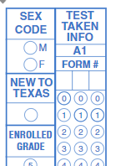
STAAR Manual Review: Student Data Collection
Manual pg. 11
New to Texas:
For all administrations (paper and online), districts should mark the “NEW TO TEXAS” field for any student who transferred into a Texas School or district from out-of-state during the current school year.
Note to CTC:
Refer to PowerSchool Manual to run your EOS report. It is recommended if possible, to capture information prior to test day.
https://www.dallasisd.org/cms/lib/TX01001475/Centricity/Domain/72/Test%20Coordinator%20Manual_8.6.20.pdf
For paper test administration sessions this information should be captured on answer document
For online test administration sessions, information should be captured in the attributes field of the online system.

Slide 16
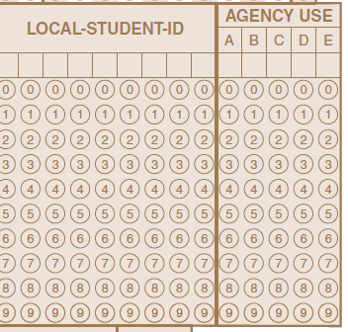
STAAR Manual Review- Student Data Collection
Manual pg. 11
Time to Test:
STAAR tests for grades 3-5 are designed to be completed within two hours.
Time-to-test information will be collected for all subject areas and must be recorded for any student who takes more than two hours.
Indicate this by marking “0” in column A of the AGENCY USE field on the answer document.
For multiple-subject answer documents, use column A if the student needs more than two hours on the mathematics test and column B if the student needs more than two hours on the reading test.

Slide 17


STAAR Manual Review
Pay attention, I have something important to say!
**Note to CTC- the next section of slides are a review of the manuals. It is recommended that Test Administrators highlight and bookmark key parts. As CTC you must read the manual prior to training to understand key parts for your training.

Slide 18
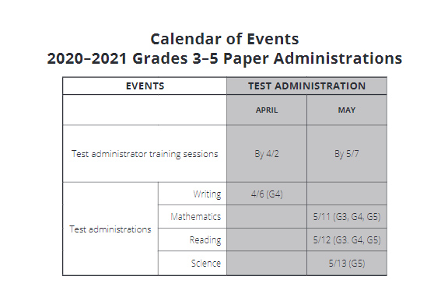
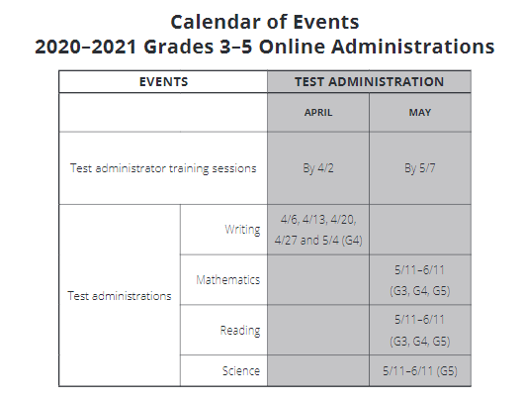
Calendar of Events
Grades 3-5 Administrations
Manual pg. 7

Slide 19
STAAR Time Limits and Policies and Procedures
Manual pgs.. 9-11
Students will have 4 hours to complete their tests unless they receive extra time as a designated support (students with extra time may have until the end of the regular school day).
Distribution of materials and the reading of test script directions are not included in the time limit. The time limit period will start after the test administrator has read directions and tells students to begin working on their test.
The start and stop times must be documented on the seating chart. You should have 4 times recorded on your seating chart.
You must also record your lunch stop and start (resume) times.
Test Administrators are to communicate (orally or in writing) the amount of time left to test in one-hour intervals and, if desired, shorter intervals during the last hour. Remind students all answers must be recorded within the allotted time period.
Make sure to collect test materials if a student leaves the room for any reason other than restroom break.
The clock does not stop for | The clock does stop for
water breaks restroom breaks snack breaks short physical or mental breaks | lunch emergency situations that significantly interrupt testing consolidation and movement of students to another testing area medical breaks

Slide 20



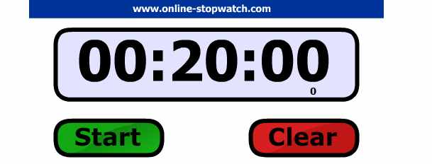
Keeping Time
Allowable Timers
Not Allowed
General Timer
Cell Phones
Smart board with Online Stopwatch

Slide 21

Accommodations
Your testing rosters will indicate which students are to receive accommodations. Ask your TC before testing, if you are unclear of any accommodations.

Slide 22
Accessibility Features
Manual pgs.. 12-13
Certain accessibility features may be provided to students based on their needs. Students cannot be made to use them. Common Accessibility Features include (see page 12-13 for full list):
■ allowing a student to use a bilingual dictionary (word-to-word translations; no definitions or examples) on mathematics, science, and social studies assessments.
■ allowing a student to read the test aloud to facilitate comprehension (includes use of PVC pipe or recording device).
■ reading aloud or signing the expository or persuasive writing prompt to any student who requests this assistance.
■ providing reading assistance on the grade 3 mathematics test for any student:
The test administrator may read a word, phrase, or sentence in a test question or answer choice to any grade 3 student, but only when asked to do so by the individual student.
If a student needs the entire test read aloud, the eligibility criteria for an oral administration must be met.
■ making assistive tools available such as various types of scratch paper, various types of highlighters, colored pencils, etc..
■ allowing individual and small-group administrations.
■ reminding students to stay on task.

Slide 23
STAAR Manual Review: Accommodations/Accessibility Features
Online Accessibility Features Available to All Students
Zoom | Color Settings | Guideline Tool | Highlight Tool | Pencil tool | Sticky Notes
used to change the screen size and use the arrows to move the screen | used to change the color settings in the application | used to help students focus attention on specific lines available on text-paragraphs, stand-alone items, etc.. | used to highlight text | used to make marks and annotations works on all parts of the test and on all platforms (e.g., graphics in test questions, EXCEPT on graph paper, reference materials/sheet, pop-ups, etc.) | used to make notes in the application 500-character count limit for each sticky note students may open a maximum of 15 sticky notes
Note to CTC:
Be sure students have had a chance to go over the STAAR tutorials.
There is a full PowerPoint on the online tools found in the STAAR platform.
The PPT may be found on our website under Assessments > STAAR > STAAR Resources > Online System: Becoming Familiar with STAAR Tutorials and Online Tools

Slide 24

2020-2021 Accessibility Updates
Content and Language Supports:
Beginning in spring 2021 pre-reads in STAAR Reading Language Arts tests will only be provided prior to reading selections and editing passages
Individual or small-group administrations:
Number of students in small group is determined at local level based on the needs of each student.
Number of students in a small group should mirror, as much as possible, the same group size in classroom testing situations.

Slide 25
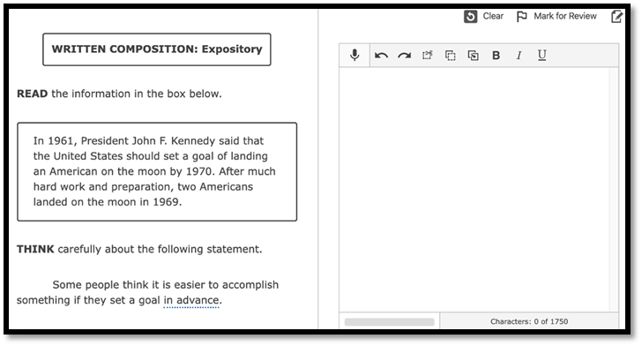
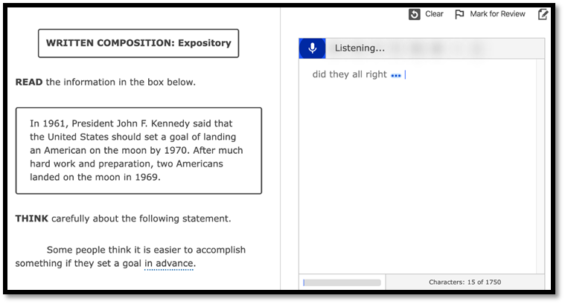
Speech-to-Text
  Embedded Speech-to-Text Tool
  Available online starting with the December 2020 EOC administration ONLY for students who meet the eligibility criteria for Basic Transcribing or Spelling Assistance
  Students should practice using the tool before testing to become familiar with functionality
  Available for written compositions only including Spanish grade 4

Slide 26
Designated Supports
Manual pgs.. 14-17
Designated Supports: These are locally-approved supports for students who meet eligibility criteria. These supports are approved by committee decision and should not be given unless documented and predetermined by appropriate decision-making committee. Each designated support policy document located on the Accommodations Resources webpage contains an Eligibility Criteria section and an Authority for Decision and Required Documentation section.
Large Print
Manipulating Test Materials
Mathematics Manipulatives
Oral/Signed Administration
Spelling Assistance
Supplemental Aids
    Basic Transcribing
    Braille
Calculation Aids
Content and Language Supports
Extra Time
Individualized Structured Reminders

Slide 27
Basic Transcribing-
Grade 4 Written Composition
For any grade 4 student who is taking the STAAR writing test online, the test administrator may transcribe (i.e., type) the student’s response to the written composition into the online test. The student does not have to be eligible for Basic Transcribing to receive this assistance and it does not need to be documented in the Assessment Management System.
  Note: This is not a requirement of the administration and decisions regarding this provision must be based on individual student need.
The test administrator transcribing the student’s response must do so in accordance with guidelines for Basic Transcribing found on TEA’s Accommodations Resources webpage.
Students in all other grades and subjects must meet the eligibility requirements for Basic Transcribing if this accommodation is needed.

Slide 28
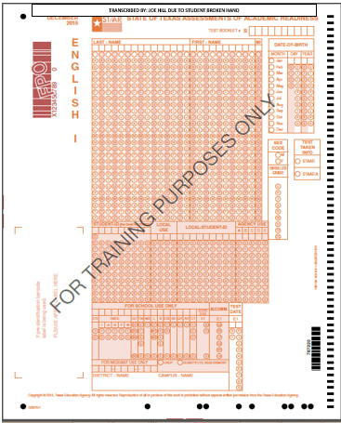
Basic Transcribing
For a student who meets the eligibility requirement, this designated support allows a test administrator to transfer student responses onto an answer document or into the STAAR Assessment Management System for online administrations when a student is unable to accomplish this task independently.
Example/Type
The test administrator may carry out Basic Transcribing to transfer student responses onto the answer document or in the Texas Assessment Management System for online administrations in these situations only.
The student writes or circles responses in the test booklet for multiple-choice or griddable questions.
The student points to responses in the test booklet or on the computer screen for multiple-choice questions.
The student dictates or signs responses for multiple-choice and griddable questions.
The student writes responses on another workspace (e.g., scratch paper, dry erase board) or types responses on a word processor for multiple-choice questions, griddable questions, or the writing prompt.
The student uses speech-to-text software to indicate responses for multiple-choice questions, griddable questions, or the writing prompt.
The person who completed basic transcription should write “Transcribed by (name) due to (reason)
Example:
Transcribed by John Jones due to basic transcription support

Slide 29
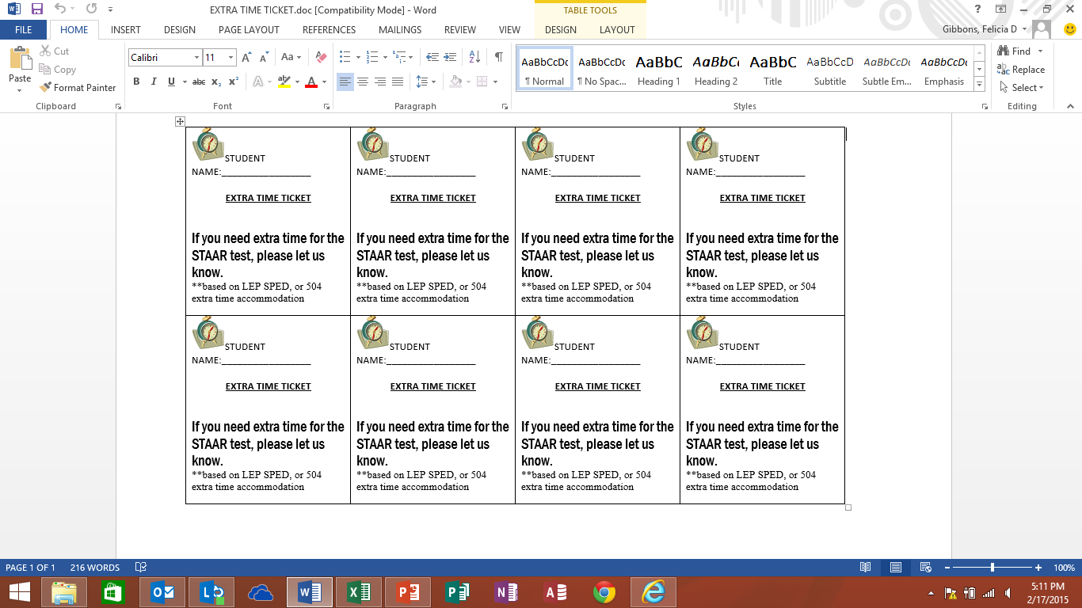
Extra Time
For students who meet the eligibility requirements for this designated support, please note the following:
Student should be allowed to continue testing until the end of the regularly scheduled school day but cannot be required to continue testing until that time.
A student who receives extra time to complete his or her test may be transferred to a different location after the original testing session has ended. Testing personnel must be made aware of the monitoring requirement when students are transferred from one area to another. Students are not permitted to transport test materials outside the testing environment.
IMPORTANT: Extra time testing sessions should start at the beginning of the school day and may go until the end of the regularly scheduled school day for all subjects. Extra time testing sessions must NOT extend beyond a typical seven-hour school day for any one student.
Policy Update for Extra Time (Same Day) – Effective 02/10/2020
A note was added to the "Student Eligibility Criteria" section clarifying the policy for ELs taking STAAR Spanish.
Link: Extra Time (revised)
**Note to CTC- campuses may decide to use the sample extra time ticket below. If not, please edit slide. The sample form is located on SNA website under “Commonly used forms-during testing.”
Campus decision to use

Slide 30
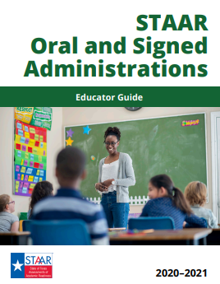
Oral Administration
Oral Administration is a designated support in which test questions and answer choices are read aloud or signed to a student who meets the eligibility criteria. For students taking STAAR online, OA is delivered using text-to-speech functionality.
Test administrators must review and be trained in the procedures specific to oral administration based on the Oral/Signed Administration Guidelines prior to administering an assessment.
    Test administrators must be familiar with what is and is not allowable to be read during oral administration for each different subject.
Test administrators who will provide oral administration must receive a copy of this manual and must attend additional campus training.
NEW: TEA has developed an online module for Oral Administration.
https://tea.co1.qualtrics.com/jfe/form/SV_9RAar0XqJq11lDD
Oral/Signed Administration for Test Administrators
This module is intended for test administrators who will provide the designated support of Oral/Signed Administration. The module focuses on the “Oral/Signed Administration Educator Guide as well as Oral/Signed Administration for Reading/Language Arts tests.”

Slide 31
Oral Administration Continued
Mathematics
The entire mathematics, science, and social studies assessments may be read aloud to a student.
Reading
For reading assessments (including the reading section of English I, English II, and English III), only the questions and answer choices may be read aloud.
Writing
No part of the editing selections, test questions, and answer choices in a writing assessment, may be read aloud. However, the revising selections, questions, and answer choices may be read aloud to a student on a writing test.
The reading selections may NEVER be read aloud to a student.
Additionally, reading aloud the expository or persuasive writing prompt is an accessibility feature allowable for any student who requests this assistance.

Slide 32
Oral Administration
Test Administrators administering a paper oral administration site must have a book with the same form number as student test books for themselves and their students. Ex: Test administrator A has OA testing site with 11 students. Therefore 12 books are needed: 11 for students, 1 for TA. All books should have same form number.
When you check out your materials, please verify that the books you received are Form 01. If not, please notify your campus test coordinator during the check out process.
If a student only has OA on day 2 of testing, they should still start with a test book with the form number that will be used for oral administration on day 2. Your campus TC should label the book with the name of the student to ensure you are aware the student must start with the assigned book.

Slide 33
Accommodations in Unexpected/Emergency Situations
Manual pg. 15
Unexpected or emergency situations that necessitate the use of an accessibility feature or designated support may occur just prior to or on the day of the state assessment.
  For example, a student may arrive at school without his or her prescribed eyeglasses and need a large-print test booklet, or a student may have a broken arm and need his or her responses transcribed onto the answer document.
  When considering how to meet a student’s needs in these types of situations, student independence should be a priority.
  *Please call TC Support or a district-wide testing coordinator for guidance with these situations.

Slide 34

STAAR Dictionary Policy
Campuses must ensure that dictionaries are available to all students taking
  STAAR grades 3–8 reading;
  STAAR grades 4 and 7 writing;
  STAAR English I, English II, and English III;
  STAAR Spanish grades 3–5 reading; and
  STAAR Spanish grade 4 writing
  Use a 1:5 student ratio
*Note: The STAAR online platform has an embedded dictionary available to all students taking STAAR assessments online.
The following types of dictionaries are allowable:
Standard/general monolingual dictionary in English or the language most appropriate for the student
Dictionary/thesaurus combination
Bilingual dictionary (word-to-word translations; no definitions or examples)
ESL dictionary (definition of an English word using simplified English)
Picture dictionary
Sign language dictionary
Both paper and electronic dictionaries are permitted. However, electronic dictionaries that provide access to the Internet or have photographic capabilities are NOT allowed.

Slide 35
Questions???

Slide 36

Test Security and Confidentiality
**Note to CTC- the next section of slides discuss test security violations, both procedural and serious. Please be sure to emphasize the violations that have occurred before on your campus. Please also emphasize that not completing seating charts in its entirety, both part I and II, is considered an irregularity.

Slide 37
STAAR Manual Review: Test Security- Technology Used During Assessments
Manual pgs. 20-21
Test administrators must actively monitor the use of the technology, including technology-based accommodations, during an assessment. For a device or software to be considered appropriate for state assessment use, it must:
be set in a mode that locks the user into a specific software program;
block the user from accessing functionality that may violate test security, such as
  The ability to send secure test content (e.g., messages, captured images, videos);
  the ability to send or receive any person-to-person communication about secure test content (e.g., chat, video); and
  the ability to save secure test content.
When using applications on a tablet, laptop, or desktop computer, campuses must ensure the application does not provide functionality that compromises the content being assessed.

Slide 38
Test Security-Serious Irregularities
Manual pgs.. 21-22
  Serious Irregularities can result in the individual(s) responsible being referred to the TEA Educator Certification and Standards Division for consideration of disciplinary action. Conduct that constitutes a serious testing irregularity may include, but is not limited to, the following:
      directly OR indirectly assisting students with responses to test questions
        providing, suggesting, or indicating a test question response
        aiding or assisting a student with a response or an answer to a secure test question
        identifying incorrect responses for students
      tampering with student responses
        changing or altering a student’s response or answer to a secure test item
      viewing secure test content before, during, or after an assessment unless specifically authorized to do so
      discussing or disclosing secure test content or student responses
      scoring students’ tests, either formally or informally
      duplicating, recording, or electronically capturing confidential test content unless specifically authorized to do so
      failing to report to an appropriate authority that an individual engaged in any of the events listed previously or in any other serious violation of security and confidentiality

Slide 39
Test Security- Procedural Irregularities
Manual pgs.. 22-26
  Procedural irregularities are less severe, more common, and typically the result of minor deviations in testing procedures. Some examples of procedural irregularities include:
      Monitoring errors
      Eligibility errors
      Accommodation errors
      Improper accounting for secure materials
      Failure to read script verbatim
      Duplicating, recording, or electronically capturing confidential test content unless specifically authorized to do so
      Student permitted to test beyond allocated time
      Student issued test material or test tickets belonging to another student

Slide 40
Test Security- Irregularity Examples
Manual pgs.. 21-26
Not actively monitoring students during testing
Test administrator leaving students alone during testing
Materials not secure. Test administrator not present in room, but test materials visible (on desk, etc.)
Test administrator using cell phone during testing
Students using cell phones during testing
Student does not record answers on answer document and/or a test administrator accepts a blank answer document
Ineligible students were tested or given the wrong assessment
Incorrect student bubbling on blank scantrons
Viewing a test before, during, or after an assessment without authorization
Discussing secure test content or student responses
Failure to read directions as prescribed in manual

Slide 41
Test Security- Effective Monitoring
Manual pgs.. 32-34
Move around the classroom
Constantly observe the students
Maintain a QUIET testing environment the entire time (even if your class is finished)
Follow required accommodations/designated supports
Check that students have appropriate test booklet
Check for cell phones and electronic devices
*Staff Members SHOULD NOT use electronic devices as well*

Slide 42
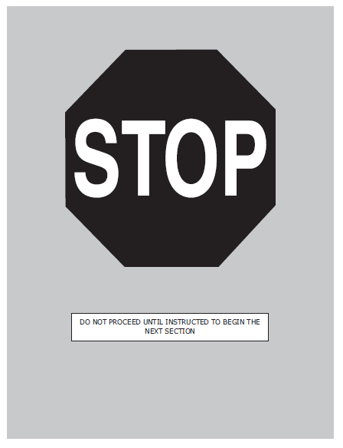
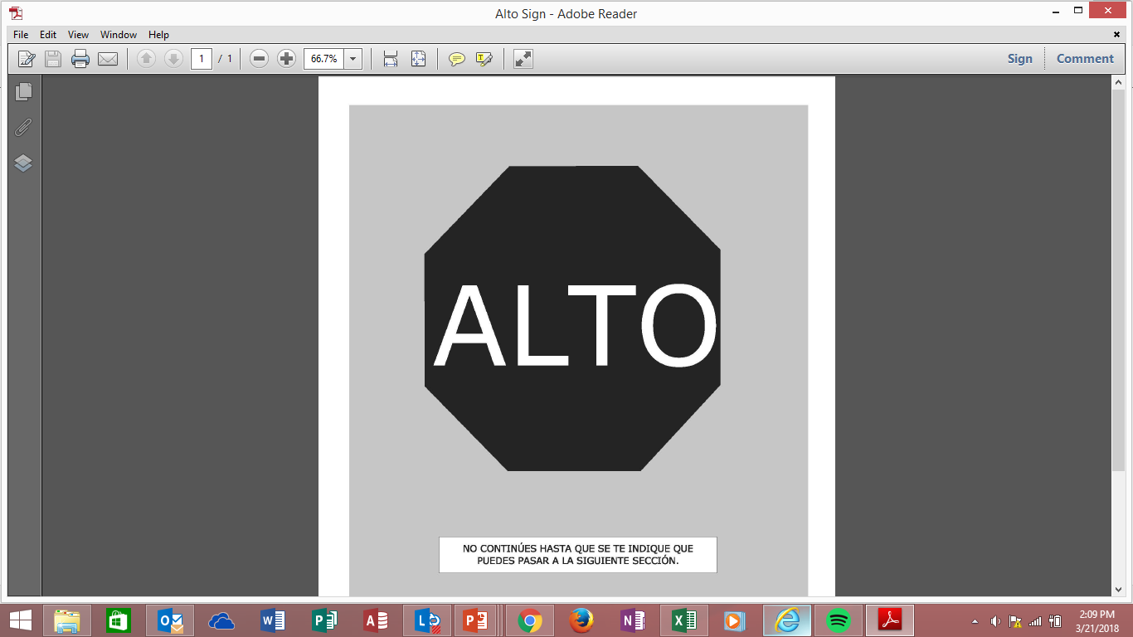
Effective Monitoring-
STAAR Stop Sign
**Note to CTC - TEA recommends teachers are given a copy of the stop sign to post in their classrooms so students know when they see this page, they stop testing. Sign available in both English and Spanish on the Assessment website under the STAAR tab.
Seals have been removed from test booklets and replaced with a STOP sign at the end of each section.
Printed copies of the stop sign should be placed in test administrators buckets.
Test administrators should post the sign at the front of the room and remind students when they reach the stop sign to inform the test administrator.
Test Administrators must actively monitor so that students do not work beyond the stop sign.
DO NOT use paper clips, binder clips, or any other type of clips to bind the pages together. They must stop when they come to this page.

Slide 43
Test Security- Ways to Avoid an Irregularity
Never leave test materials unsupervised
As soon as a student finishes testing, inspect answer document and if student did not bubble all answers say, “You have not recorded all of your answers on the answer document, please do so now.”
Actively monitor students at all times, especially with the writing prompts
Ensure students understand there is not free time if they finish early. They may read a book or put their head down
Verbal/written reminders of time remaining to test to ensure students have time to record answers on answer sheet
Review small group rosters in advance
All Irregularities should be reported to your campus TC immediately, do not wait until testing is over

Slide 44
STAAR Manual Review: Test Security and Confidentiality- Penalties for Violations of Security
Manual pgs. 27-28
As indicated in TAC, §249.15, any person who violates, assists in the violation of, or solicits another to violate or assist in the violation of test security or confidentiality, as well as any person who fails to report such a violation or fails to cooperate with a TEA investigation, is subject to the following penalties:
placement of restrictions on the issuance, renewal, or holding of a certificate, either indefinitely or for a set term;
issuance of an inscribed or non-inscribed reprimand;
suspension of a certificate for a set term or issuance of a probated suspension for a set term; or
revocation or cancellation, which includes accepting the surrender of, a certificate without opportunity for reapplication for a set term or permanently; or
imposition of any additional conditions or restrictions upon a certificate that the SBEC deems necessary to facilitate the rehabilitation and professional development of the educator or to protect students, parents of students, school personnel, or school officials.
As stated in the TEC, §39.0303, Secure Assessment Instruments, Criminal Penalty, A person commits an offense if:
the person intentionally discloses the contents of any portion of a secure assessment instrument developed or administered under this subchapter, including the answer to any item in the assessment instrument; and
the disclosure affects or is likely to affect the individual performance of one or more students on the assessment instrument.
An offense under this section is a Class C misdemeanor.

Slide 45

STAAR Manual Review: Test Security- Seating Chart Reminders
Seating Chart Reminders:
Complete ALL parts of the seating charts.
The top heading of each page MUST be filled out in its entirety.
Complete ALL student columns.
Complete the blank diagram on page 2.
Only include students who were present and tested in your classroom.
Make sure to include start and stop times.
When writing book numbers for paper test sessions, please note that each test booklet contains a 10-digit security number printed on the back of each booklet. Ignore the letter “S” before the number.
Seating Chart Must Include the Following:
Campus Name and TEA #
Room number, date
Complete name of test administrator(s)and signatures
Test taken subject area, grade level (if required).
Testing start and stop time(s) including lunch times, if applicable
Complete name of each student testing, student ID number
Booklet number and form number, as applicable
Complete name of relief personnel
**Every class must submit a seating chart for each day of testing using the DISD General Seating Chart. Failure to complete ALL portions of the seating chart is considered an irregularity.

Slide 46

Preparing for Testing
Pay attention, I have something important to say!

Slide 47
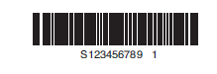
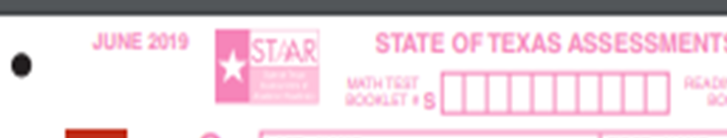


Student Test Book Numbers
Manual pg. 34
Each test book contains a 10-digit security number printed on the back of each book. An example is shown below. Ignore the letter “S” before the number.
One number per box
The “S” should not be included only the ten digits after
**Note to CTC- It is recommended to give this slide as a handout in your test booklets or have Test Administrators write example on board to help students correctly write their book numbers at the top of their answer sheet.
If your entire campus is testing online, then you may delete this slide.

Slide 48
4th Grade Writing Assessments
Manual pg. 37
Ensure the procedures below are followed during the 4th grade writing assessments:
■ The test administrator may read aloud or sign the writing prompt to any student who requests this assistance
■ Reading or discussing student compositions is not allowed at any time
■ Editing selections may NEVER be read aloud to a student
■ At no time before, during, or after the administration of the assessment are test administrators permitted to assist students with their written compositions
■ The test administrator must NOT do the following:
  elaborate on the prompt
  give students an opening and/or closing sentence
  give students an outline for organizing their composition
  give students ideas about how to develop their composition
  translate the prompt into another language (except sign language)

Slide 49
Students who become sick during testing
Note to CTC, this is found in DCCR, the manual only mentions this as it relates to online testing
Make-up testing may also be used for a student who becomes sick and leaves campus during the test. If the student has not completed the assessment, he or she may complete the test within the scheduled administration dates. Test administrators should keep track of the amount of time a student used on the first day so that the student is provided the remaining test time to complete the test on the make-up day.
Test administrators should use a paperclip to separate the questions the student has completed on the first day so the student does not go back to those questions on the make-up day. This applies to
  grades 3-8 mathematics
  grades 5 and 8 science
  grade 8 social studies
  Algebra I, Algebra II, Biology, and U.S. History
Test administrators should use a paperclip to separate the passages and related questions that a student has completed on the first day so the student does not go back to those passages and related questions on the make-up day. This applies to
  grades 3-8 reading
  grades 4 and 7 writing
  English I, English II, and English III
For online administrations, test administrators should remind the student not to go back to previously answered questions and should closely monitor the student to make sure he/she does not go back to previously viewed content. The test will lock after 12 hours.

Slide 50
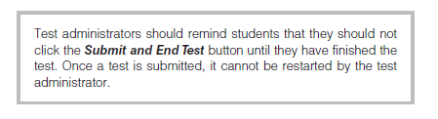
Online Testing
Manual pgs. 35-38
Manual pgs. 42-44
Reminder: Any student is eligible to test online unless indicated by IEP or IAP. Students should complete the tutorial prior to testing online.
Students testing online will need a student test ticket to log in to the ETS system.
  Test Administrators may log in to the test for students within 30 minutes of testing instead of allowing students to do so.
If a student needs to take a break, you may pause the test.
To pause the test, the student clicks the Pause button. The test administrator should provide assistance for students who need help pausing their tests. To resume a test, the student should be instructed to click Resume on the Pause screen.
If a test is paused for more than 30 minutes the student will automatically be logged out. To resume testing, the student must log back in using the original student test ticket.
Students in an online test administration should log out if they take a lunch break. To log out of the test, students click the Logout button.
Ensure students have properly exited test BEFORE sending them back to class.
**Report any online issues IMMEDIATELY to campus test coordinator.

Slide 51
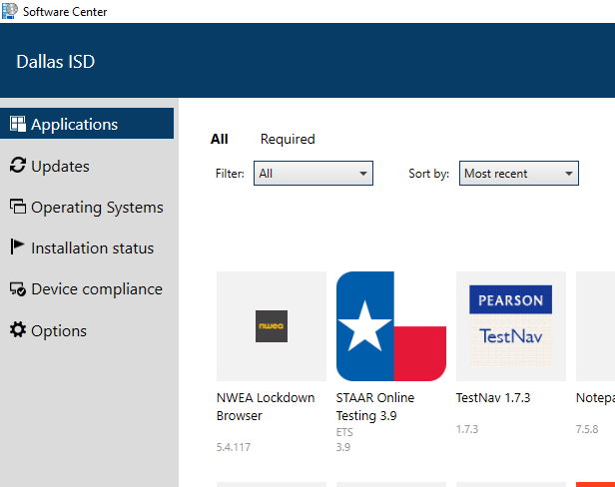
STAAR Manual Review: Starting an Online Test
Immediately prior to testing, test administrators must provide each student his or her own student test ticket.
Note: Students must be on campus to test. Test administrators should not share test ticket information such as username and password information with students via Zoom, Teams, or other platforms.
The student will launch the STAAR Online Testing Platform secure browser and log in using the username, password, and session ID provided in the student test ticket.
  Student test tickets contain the unique username, password, and Session ID needed to log in to take the test, and, if applicable, information about embedded supports.
  Student test tickets must be stored in a secure location prior to the test administration.
  It is imperative to ensure students receive their correct ticket. Be sure to have students review name and grade to ensure incorrect tickets are not given to students.
The test administrators will guide students through beginning the test.
**Report any online issues IMMEDIATELY to campus test coordinator.
Make sure you are launching test using the STAAR app located in the DISD software center with the most current version.
**Note to CTC: Information on printing student test tickets can be found on our website under the Assessment Tab>STAAR>Navigating the ETS Online System for STAAR Testing

Slide 52
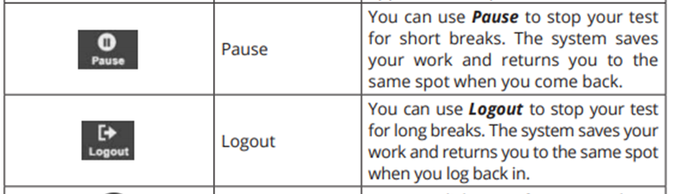
STAAR Manual Review: Pausing an Online Test
If a student needs to take a break, you may pause the test.
To pause the test, students click the Pause button. The test administrator should provide assistance for students who need help pausing their tests. To resume a test, students should be instructed to click Resume on the Pause screen.
If a test is paused for more than 30 minutes the student will automatically be logged out. To resume testing, the student must log back in using the original student test ticket.
Students in an online test administration should log out if they take a lunch break. To log out of the test, students click the Logout button.
Ensure students have properly exited test BEFORE allowing them to leave test session
Test Administrators should remind students that they should not click the Submit and End Test button until they have finished the test Once a test is submitted, it cannot be restarted by the test administrator.
Students who cannot finish their tests due to illness or a testing irregularity should not click the Submit and End Test button. The student should log out of the test. **Please notify TC in this instance for additional guidance.
**Report any online issues IMMEDIATELY to campus test coordinator.

Slide 53
STAAR Manual Review: Stopping an Online Test
Submitting a student test
Once a student has submitted a test, the student will no longer be active in the test session and cannot access the test with his or her student test ticket. The following steps submit the test and end the session for a student.
On the Review/End page of the test, click End Test
Check the “I understand I cannot return to the test” box.
Select the Submit and End Test button.
Test administrators should verify student tests are submitted correctly and collect student test tickets before students are allowed to leave the testing room.
The test will be submitted for scoring via the Assessment Management System as soon as the student clicks the Submit and End Test button.
If a student clicked the Submit and End Test button accidentally, contact your campus testing coordinator.
**Report any online issues IMMEDIATELY to campus test coordinator.

Slide 54
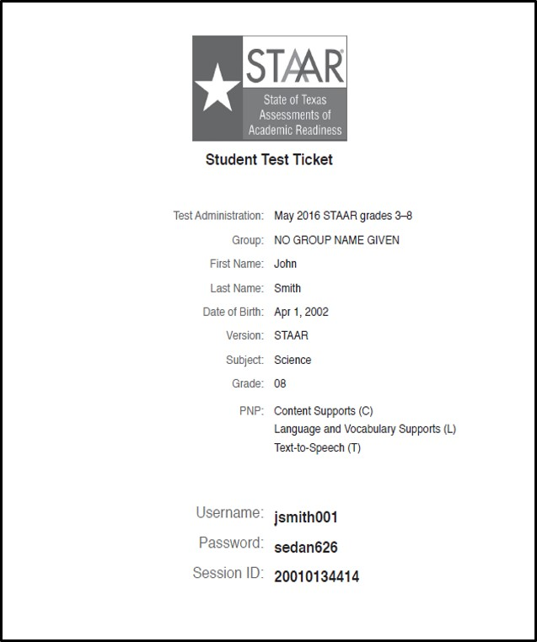
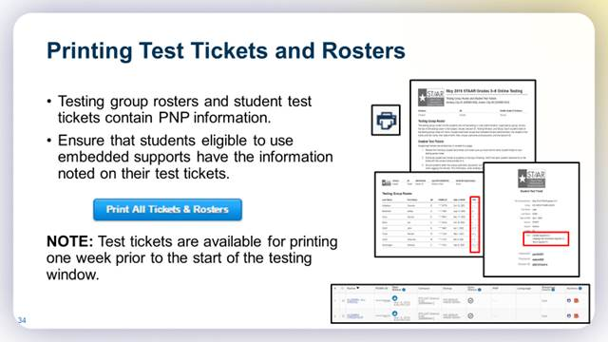

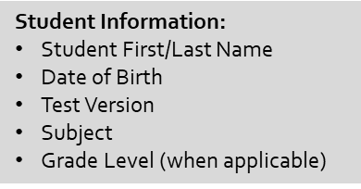


Student Test Tickets

Slide 55
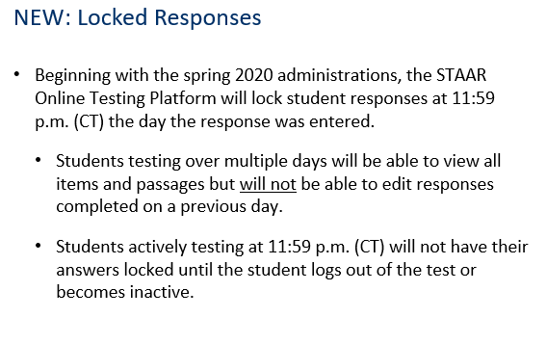

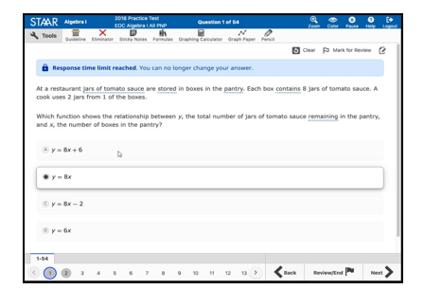
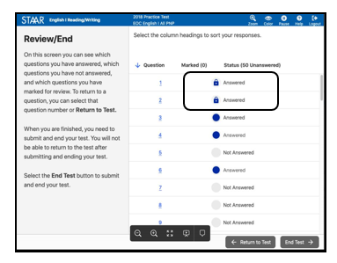
Locked Responses
Locked responses will look like this:

Slide 56
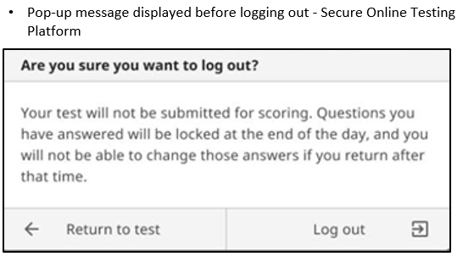
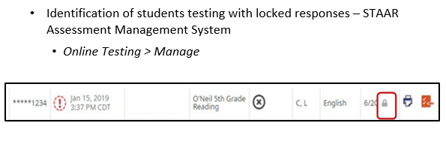
Locked Responses
Confirmation of locked responses

Slide 57
Online Testing Key Pages
Starting Online Test –Manual page 38 and Appendix B
Submitting the Test- Manual page 42
Marking New to Texas Information in the Assessment Management System- Manual page 42
Entering Student Score Codes Online – Manual Page 44
Entering Student Accommodations Online – Manual Page 43
Online Tools –English/Spanish Appendix C

Slide 58
Paper Administration directions begin on page 50 of your manual for Writing and page 57 for Math, Reading, and Science. The directions for Spanish Writing begin on page 63 and the directions for Spanish Math, Reading, and Science begin on page 70.
Online Directions begin on page 77 of your manual for English and page 85 for Spanish.
It is important to read and highlight your directions in advance.
Directions must be read verbatim.
Remember, this training does not take the place of reading your manual.
Administration Directions

Slide 59
Questions???

Slide 60

Student Answer Sheets
**Note to TC: If your entire campus is online, you may delete slides .
While reviewing this section, make sure to emphasize the difference in precoded and hand gridded answer documents to ensure students do not bubble demographic information on documents that are already precoded.
Additional Sample STAAR Answer Sheets for Training Purposes may be found in the DCCR for each tested subject. https://txassessmentdocs.atlassian.net/wiki/spaces/ODCCM/pages/265814308/2020+2021+Answer+Documents+for+Training+Purposes
Hold on! The end is in sight.

Slide 61

Elementary Answer Sheet Sample
Test Booklet Number:
**Students should complete based on the number located on their student booklet.
Test Taken Info
The language of assessment must be bubbled for each subject. Be sure the correct language is bubbled or student scores will not be accurate.
Local ID is left justified without leading zeros
New to Texas Indicator
Precoded Answer Documents will include a small imprint in this area. Do NOT hand-grid answer documents with precoded information unless the precoded information is incorrect.
All student information and program information hand-gridded on the answer documents must be completed using only a No. 2 pencil.
Form number must be written AND bubbled below
Time to Test (primary administrations only)
Score Code
A= absent
O= other
*= tested Online
P=previously passed (SSI retest only)
PW=parental waiver (SSI retest only)
S= Score
Score Code Field indicates whether a student’s test should be scored
Failure to grid correctly may result in a score of zero
Student Accommodation Field
The following accommodation bubbles may be available, depending on the test and/or the mode of testing.
  DS = Designated Support
  LP = large print
  XD = extra day (requires TEA approval)
  OA = Oral Administration
  EE = Spelling Assistance

Slide 62
Additional Sample STAAR Answer Sheets for Training Purposes
https://txassessmentdocs.atlassian.net/wiki/spaces/ODCCM/pages/265814308/2020+2021+Answer+Documents+for+Training+Purposes
Note to CTC, this slide can be deleted. A sample of each grade/subject answer sheet may be found on the above website link. It is recommended that you give test administrators a copy of a sample answer sheet for their grade indicating what areas should be complete prior to turning in to you at the conclusion of testing each day.

Slide 63

Spring 2020 Test Material Reuse
As a measure to reduce waste and ensure fiscal responsibility, districts will receive unused STAAR paper materials from the spring 2020 testing season, EXCEPT
  the English I, English II, and English III answer documents and test booklets; these test booklets will be labeled April 2021 and the answer documents will be labeled April (no year); and
  the May 5 and 8 mathematics and reading administration; test booklets from this administration will be labeled April 2020, standard answer documents will be labeled May (no year), and embedded supports and braille answer documents will be labeled April 2020.

Slide 64
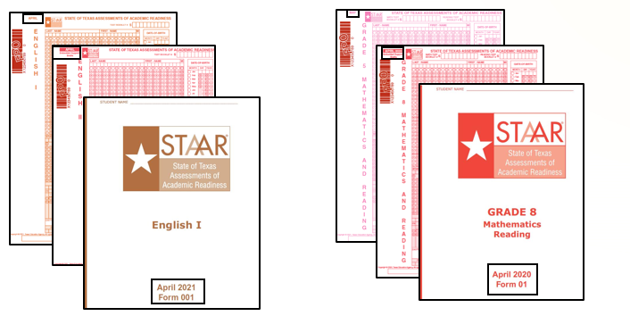
Spring 2020 Test Material Reuse

Slide 65
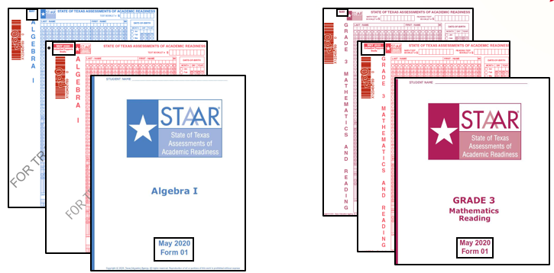
Spring 2020 Test Material Reuse

Slide 66

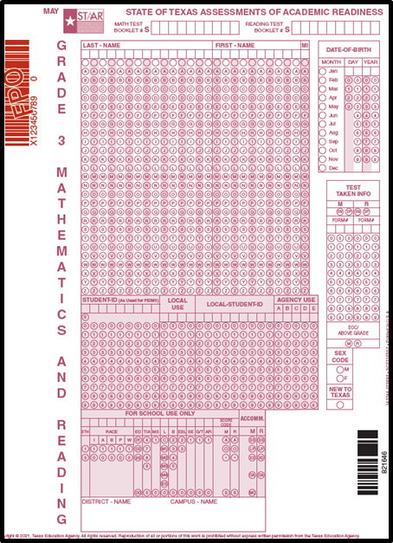

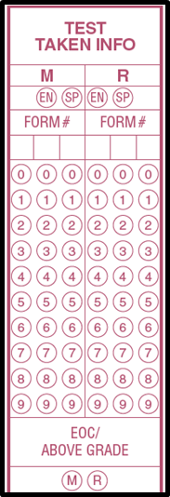
Three Digit Form Numbers
Beginning in December 2020, all answer documents have a three-digit form number field. All three digits entered on the test booklet must be written and gridded in the form number field on the answer document.
If the test booklet only has two digits, both digits should be written and gridded with a zero in front to make a three-digit number.
NOTE: Does not apply to Braille or STAAR Paper with Embedded Support answer documents since these assessments do not have a form number field.
Grid 001 in the form # field.

Slide 67
Paper Testing: The following items should be returned to your campus TC:
Testing Roster
Seating Charts with Part I and II completed
Test Administrator Manual
Student Answer Sheets (do not place inside of books) should be in alphabetical order
Student Test Booklets should be in numerical order
Cell phone script (if used)
Absentee roster
Scratch Paper
Pencils
Supplemental Aids (if used)

Slide 68
Online Testing: The following items should be returned to your campus TC:
Testing Roster
Student test tickets
Ensure test is submitted
Ensure Answer Document Fields have been completed (Time to Test and New to Texas, if directed to enter)
Seating Charts with Parts I and II completed
Test Administrator Manual
Cell phone script (if used)
Absentee roster
Scratch Paper
Pencils
Supplemental Aids (if used)
Headphones
i

Slide 69
Overview- Test Administration
Distribute materials and give directions as directed in your manual. Do not deviate from the directions. You will say what appears in bold print. You may repeat directions as many times as needed.
Verify that students have put their test booklet number on their answer document. Students should not put the “S”.
Verify that students have written their first and last name on their test booklet.
If precoded student information is correct, then students should not bubble any student demographic information.
Students should use No. 2 pencils, not mechanical pencils.
Students should sit quietly when finished or read a book. DO NOT ALLOW STUDENTS TO SIT WITH MATERIAL ON DESK WHEN THEY ARE FINISHED.
Actively monitor at all times.
All testing irregularities must be reported to Dallas ISD Office of Test Security and on the TISV form.
Once students are finished, collect their test book and answer sheet in separate stacks. DO NOT ALLOW STUDENTS TO PLACE ANSWER SHEET INSIDE OF BOOK AS THEY TURN MATERIALS IN TO YOU.
Ensure the following is marked on answer sheet:
  Test taken information and form number
  New to Texas (if applicable)
  Score Code
  Accommodations (if applicable)
  Time to Test (if applicable)

Slide 70
Questions???

Slide 71

Know Your Responsibilities
Remember…
This training does not take the place of reading the manuals. There is no substitute for reading the manual.
Thank you for your time and attention!
A copy of this PowerPoint will be emailed to you for review.
Please turn your oath in at this time.

Slide 72

Oral Administrator Training
** Note to CTC- it is required that after your group training, you go over the OA guidelines with those test administrators who will administer oral administration to ensure they understand books with the same form number are needed for the students AND themselves. Be sure they understand what can and cannot be read as per the guidelines outlined in the OA guideline manual.

Slide 73

STAAR Manual Review: Accommodations- Designated Supports- Oral Administration
For a student who meets the eligibility requirements, Oral Administration is a designated support in which test questions and answer choices are read aloud or signed to a student. For students taking STAAR online, OA is delivered using text-to-speech functionality.
There is a SEPARATE guidelines manual for OA! Please raise your hand if you will administer an oral administration test session and did not receive the OA guidleines manual. Test Administrators administering OA sessions must:
review and be trained in the procedures specific to an oral administration based on the Oral/Signed Administration Guidelines prior to administering assessment
be familiar with what is and is not allowable to be read during Oral Administration for each different subject
complete oath
Oral and Signed Administrations Educator Guide

Slide 74
Oral Administration Test Administrator Module
TEA has developed a module intended for test administrators who will provide the designated support of Oral/Signed Administration. The module focuses on the “Oral/Signed Administration Educator Guide” as well as “Oral/Signed Administration for Reading/Language Arts tests.”
** Note to CTC- You may complete this module as a group or have Test Administrators who will administer an OA testing site, complete the module independently and provide you a copy of the certificate provided at the end of the module upon successful course completion.
Oral/Signed Administration for Test Administrators

Slide 75
Questions???

