Slide 1
ACP
Fall 2021
Assessment of Course Performance
Campus Staff Training for Grades 3-12
INSERT CAMPUS NAME HERE

Slide 2
Remember!!!
Attending this training does NOT take the place of reading the manual and following all TEA, district and campus guidelines and procedures.

Slide 3
ACP Campus Training Goals
Sign in on the attendance sheet.
Sign and turn in oath of test security.
Understand the campus testing plan and your role in its success.
Understand ACP testing procedures.
Review accessibility information and test security policies and procedures.
Understand your responsibilities after testing is complete.
Before you leave this training, make sure to:
Notes:
Ensure everyone has received a copy of the ACP manual.
Explain the topics that can found in the ACP manual as listed on the slide

Slide 4
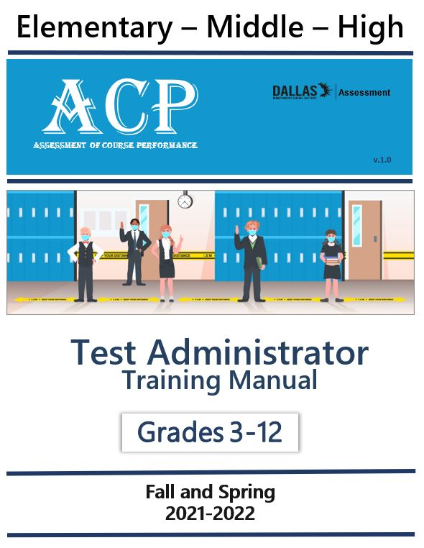
Campus Specific Information
ACP Test Administrator Manual
Campus Training Includes:
ACP administration information
Campus testing procedures
ACP components
Accessibility information
ACP Online testing
ACP Paper testing
After testing
Test security overview
Notes:
Ensure everyone has received a copy of the ACP manual.
Explain the topics that can found in the ACP manual as listed on the slide

Slide 5

Administration
&
Procedures

Slide 6
ACP Information
Assessments of Course Performance (ACPs) are a collaborative product of the Assessment Department and Teaching and Learning. ACPs are used each semester in grades 3 through 12 for STAAR tested subjects and some core electives as part of the student summative evaluation. ​
Notes:
Read slide as is

Slide 7
ACP Updates 2021-2022
Change in Test Names
EL changed to EB
Text-To-Speech
Previous secondary Pre-AP courses were renamed to Honors (i.e., Grade 7 Math Honors).
EL (English Learner) is now referred to as EB (Emergent Bilingual). For this school year, students testing online will still need access to a physical bilingual dictionary.
Text-To-Speech (TTS) is available within the DAN system and must be captured on the student's profile. All allowable content will be read to the students.
Listening Questions
Calculators
MyData Portal Reformatted
World Languages and Varsity Band tests have audio questions. In DAN, students click the play button to hear the audio portion. For paper testers, Test Administrators log into the Assessment website to access MP3 files.
Desmos is an embedded calculator that is available on the appropriate tests within DAN.
Options added to designate English or Spanish language. SPED and 504 students are blank, supports entered in IEPs/IAPs.
Notes:
This slide reflects updates for the 2021-2022 school year.
Updates include:
Changes in test names
Throughout manual you will see EB (Emergent Biligual) has replaced previous terminology ESL in alignment with the state and districts updated verbiage.
Text to speech (Oral Administration) availble within the platform for students who meet eleigibility requirement as outlined in the policy documents and to whom the request for accommdation has been captured in DAN.
Listening Questions: The DAN system will include a section for teachers to play MP3 files for the test item audio for World Languages and Varsity Band ACPs.
The availbility of Desmos as the availble calculator option within the DAN platform
My Data Portal Designated Support section reformatted to designate English or Spanish language.

Slide 8
ACP Test Administrator General Reminders
Make sure you have signed in on the meeting sign in sheet.
Read and familiarize yourself with the manual. Failure to do so could result in an irregularity.
Cover or remove instructional displays that will aid students (any instructional content regardless of subject). Only motivation posters can be left uncovered.
Read the directions you will be giving in advance. Failure to read and understand the directions will cause student tests to be completed inaccurately.
Have extra pencils and scratch paper available.
Students testing online are not allowed to have paper copies of the exams.
Ensure familiarity with Dallas ISD test policy – DISD EK (Regulation): Testing (http://pol.tasb.org/Policy/Code/361?ﬁlter=EK)
Review the ACP calculator policy to ensure that calculators are provided only for designated grades and content areas.
Based on dictionary policy, teachers should have dictionaries available in their classroom at a 1:5 ratio. An electronic dictionary is also provided within DAN. 2021-2022 Dictionary Policy Link
Ensure you are familiar with test rosters and student accommodations.
Attend the additional training sessions to cover ACP Oral Administration.
Notes:
Read slide as is.
Remind test administrators to review the ACP calcuator policy to ensure they understand which grades and subjects are allowed to use a calculator.
Te dictionary policy for ACP is the same as STAAR and the link on the slide leads you to the STAAR dictionary poicy.
It is important that test adminisrators are familiar with both the calculator and dictionary policy, as well as test rosters and student accommodatioons to ensure irregualrities do not occur.

Slide 9
Campus Specific Information Testing Procedures
**Note to TC: edit and adjust these slides to reflect campus information that your test administrators need to be aware of to ensure your testing day flows smoothly.**
All students will report to their testing site. Please review small group information with your students prior to testing.
Be at your testing location before students arrive.
Collect cell phones and have student backpacks placed at the front of the room.
No personal belongings/books/papers/etc. on student desks.
Cell phones should not be returned until all testing is complete.
No electronic devices (teacher and student) should be visible during testing.
Take attendance using the absentee form provided.
All doors should remain open.
Notes:
Ensure you have edited this slide based on your campus procedures.
Go over campus procedures to ensure a smooth testing window.

Slide 10
ACP Tested Grade Levels and Subjects
ELEMENTARY
Grade 3: Reading and Math (English or Spanish)
Grade 4: Reading and Math (English or Spanish)
Grade 5: Reading, Math and Science (English or Spanish)
NOTE: Schools housing Grade 6 should utilize to Course to Test Lookup Link to verify tested ACP subjects.
Notes:
Read slide as is.

Slide 11
ACP Tested Grade Levels and Subjects
SECONDARY Grades 6-12: Subjects are based on course enrollment
Mathematics
Reading
Spanish Reading
Science
Social Studies
English-as-a Second Language (ESL)
Course to Test Look-Up Link
World Languages
Visual & Performing Arts
Technology
Health
Physical Education
Notes:
Read slide as is

Slide 12
ACP Virtual Academy Students
Students enrolled in virtual academies will be assessed at their home campuses. These students are required to report to the campus to take ACPs. Campuses should ensure that all safety and social distancing guidelines are followed in the assigned testing areas.​
**Note to TC: It is recommended that you communicate procedures such as where virtual students will report, etc.
Notes:
Students enrolled in virtual academies will be assessed at their home campuses. These students are required to report to the campus to take ACPs.

Slide 13
ACP Mode of Testing
ACPs will be available in online and paper formats.
The Dallas Assessment Navigator (DAN) system will be used for online testing.
Special Services students must meet eligibility requirements to receive paper tests.
Teacher made exams will be created collaboratively by Special Services teachers and content area teachers. See Teacher-Made Test Guidance for Inclusion & Resource for more information.
Campuses are responsible for providing guidance on Teacher-made tests for elective courses without an ACP test.
Students must test in person at their home school.
Notes:
Read slide as is
Discuss procedures for teacher made exams such as who grades the assessment and who enters grades
Remind test administrators that students may not take ACPs virtually, students must be in person to take an ACP exam

Slide 14
Campus Specific Information ACP Testing Window
**Note to TC: edit and adjust these slides to reflect campus information that your test administrators need to be aware of to ensure your testing day flows smoothly.**
Elementary Window | Testing Dates | Bell Schedule | Tested Grades
Fall | December 13-17 | Full day | 3-5/6
Elementary schools maintain a full-day schedule for each testing day.
Test Coordinators determine the testing schedule for each content area.
Multi-age campuses that have students in 6-8 or 6-7 will have early release for those students only.
Campuses with PK-6 are considered an elementary campus and will not have early release.
SAMPLE, TC should edit
Notes:
Elementary schools maintain a full-day schedule for each testing day.
Test Coordinators determine the testing schedule for each content area.
Provide your campus schedule including subjects/periods tested each day, start and stop times, and lunch information

Slide 15
Campus Specific Information ACP Testing Window
**Note to TC: edit and adjust these slides to reflect campus information that your test administrators need to be aware of to ensure your testing day flows smoothly.**
Secondary Window | Testing Dates | Bell Schedule | Tested Grades
Fall | December 13 | Full day | 6-12
 | December 14-17 | Half days | 6-12
Secondary schools receive dismissal times assigned by School Leadership for each testing day. Refer to the School Leadership WAIP for dismissal times.
SAMPLE, TC should edit
Notes:
Test Coordinators determine the testing schedule for each content area.
Provide your campus schedule including subjects/periods tested each day, start and stop times, and lunch information

Slide 16
Campus Specific Information ACP Testing Window
**Note to TC: edit and adjust these slides to reflect campus information that your test administrators need to be aware of to ensure your testing day flows smoothly.**
FALL 2021 ACP Schedule |  | MONDAY | TUESDAY | WEDNESDAY | THURSDAY | FRIDAY
 |  | DEC 13 | DEC 14 | DEC 15 | DEC 16 | DEC 17
8:35 AM-10:15 AM | 8:35 AM- 8:45 AM ATTENDANCE & TESTING DIRECTIONS | 1st Period | 3rd Period | 5th Period | 7th Period | Report to 1st Period Class
 | 8:45 AM-10:15 AM Testing
10:15 AM-10:20 AM - Passing Period
10:20 PM-12:00 PM | 10:20 AM - 10:30 AM ATTENDANCE & TESTING DIRECTIONS | 2nd Period | 4th Period | 6th Period | 8th Period | Report to 2nd Period Class
 | 10:30 AM-12:00 PM Testing
Regular dismissal time
ACP Testing Window:
  December 13-17, 2021
  District testing is allowed on Monday.
SAMPLE, TC should edit
Notes:
Edit slide to reflect campus information for testing days
Be sure to include procedures such as time and location to pick up test material and return test material

Slide 17
Campus Specific Information Attendance Procedures
**Note to TC: edit and adjust these slides to reflect campus information that your test administrators need to be aware of to ensure your testing day flows smoothly.**
Each campus will need to determine how take attendance and identify make-up testers.
Keep in mind: campuses will likely need to develop new procedures for these two processes.
SAMPLE, TC should edit
Notes:
Edit slide to include your campus attendance procedures

Slide 18
Campus Specific Information Lunch Procedures
**Note to TC: edit and adjust these slides to reflect campus information that your test administrators need to be aware of to ensure your testing day flows smoothly.**
DAY 1 TESTING LUNCH SCHEDULE
11:00-11:30: Non-ACP classes Sped teacher made test groups, band, orchestra, AVID/college, dance, choir, STEM, theatre, Pond's classes, AEP, FLS
11:30-12:00 only ACP elective and Sped ACP small group classes that are finished per administration. Do not just bring your classes, someone will notify you.
12:00-12:30 ACP Classes called down to pick up a sack lunch.
SAMPLE, TC should edit
Notes:
Edit slide to include your campus lunch procedures

Slide 19
Campus Specific Information Small Group Locations
**Note to TC: edit and adjust these slides to reflect campus information that your test administrators need to be aware of to ensure your testing day flows smoothly.**
Small Group Testing Assignments:
DAY 1
Fajardo- 6th ACP small group testers P143
R. Wright- 7th small group ACP testers room 109
O’Donnell- 8th small group ACP testers room 126
Ballard- Elective small group ACP testers or as needed
DAY 2
Burrows- 6th ACP exempt testers library
Ballard- 7th ACP exempt testers library
M. Wright- 8th ACP exempt testers library
SAMPLE, TC should edit
Notes:
Edit slide to include information about small group testing.
Make sure test administrators understand where students are to report for small group testing

Slide 20

ACP
Components

Slide 21
ACP Components
90-minute testing window. Review sessions cannot be conducted on test days.
Maximum of 2 tests are allowed to be administered per day.
Test questions are presented in different formats to prepare students for the STAAR Redesign.
Tech-enhanced test items will not be included in the 2021-2022 ACPs.
All ACP paper booklets are consumable.
Notes:
90-minute testing window. Review sessions cannot be conducted on test days.
Maximum of 2 tests are allowed to be administered per day.
Test questions are presented in different formats to prepare students for the STAAR Redesign.
Tech-enhanced test items will not be included in the 2021-2022 ACPs.
All ACP paper booklets are consumable (students can write in book)

Slide 22
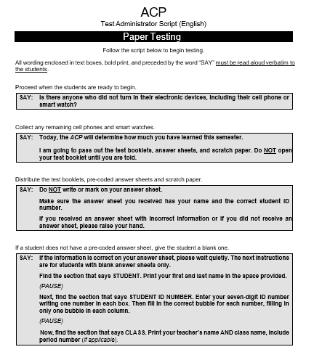
ACP Components
Grades 3-12 ACP Test Administrator scripts
  Page 41 - English
  Page 44 – Spanish
Read the script verbatim, as written.
Practice reading the script in advance.
Do not paraphrase or disregard the script.
Students work independently with general directions.
ACPs must be tested in one sitting, with no lunch in between.
Documented testing accommodations are administered.
Notes:
Read slide in its entirety

Slide 23
ACP Components
Tests taken based on course enrollment
Teacher-made tests for non-ACP courses
No modified versions of the ACPs
  Students who do not receive on-level instruction or cannot take ACPs with accommodations require teacher-made tests documented through ARD or LPAC documentation. See Teacher-Made Test Guidance for Inclusion & Resource for more information.
  504 students are not exempt from testing and are not allowed to take teacher-made exams.
ACPs count:
5% of semester grade for grades 3-5
10% of semester grade for grades 6-8
15% of semester grade for grades 9-12
Notes:
Every course does not have an ACP test. Only ACP tested subjects will have a district made ACP exam
Courses without an ACP exam will give teacher made test.
If you are unsure if a course has an ACP exam, you can refer to the Course to Test Lookup found on the district assessment site.
There are no modified versions of ACP exams.
ACPs count
5% of semester grade for grades 3-5
10% of semester grade for grades 6-8
15% of semester grade for grades 9-12

Slide 24
ACP Scores and Reports
All teachers must check and verify that all their students of record have ACP scores. TC should be informed immediately of any discrepancies.
Teachers enter test scores manually by the January 6, 2022, deadline. These test scores can be entered manually before the district's deadline to enter grades.
The final test results are displayed within MyData Portal. Online and paper test scores are not uploaded into PowerSchool and must be entered manually by the teachers of record.
If an ACP score is not found on this report, then you must submit the ACP Correction Form. ACP Corrections/Changes Link
Notes:
Read slide as is.
Ensure test administrators understand procedures for entering test scores including deadline that test scores should be input
If there is an issue with test score or a test score is not found, notify CTC immediately.

Slide 25
Teacher Vacancies for High Schools
The district grading policy acknowledges when certified teachers are not available for all classrooms.
“If a student at the high school level has been taught by a noncertified substitute teacher in a classroom with a vacancy or a teacher with extended absences for more than 25 days in Semester 1 or 30 days in Semester 2, the student’s final grade will be calculated using either the ACP examination with 15 percent weight or the average of the two nine-weeks grades, whichever is higher.”
Students must still take the ACP, if they are taught by a non-certified teacher during the testing window. Teacher-made tests and class projects cannot be used as a substitute grade.
Notes:
**This slide is for high school
Read slide as is.

Slide 26
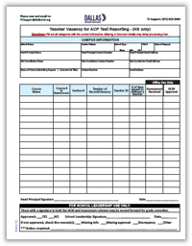
Teacher Vacancies for High Schools
Test Coordinators will take the following steps to report teacher vacancies for ACP courses
Verify all ACP courses that were not covered by a certified teacher.
Do not include non-ACP courses.
Fill out online 2021-2022 Teacher Vacancy for HS ACP Test Reporting form to list the specific ACP subjects, class sections and number of vacant days. Submit all completed pages for processing.
After the HCM Department verifies the vacancies, School Leadership sends the signed vacancy forms to Test Coordinators and principals to approve grade changes.
After receiving the ACP scores, compare the students’ exam scores and the average of the grades from the first two quarters. Enter the higher of the two in PowerSchool.
The due date is December 3 by 4:00 PM.

Slide 27

Accessibility

Slide 28
Reminder!!!
Student accommodation profiles in DAN should be updated and ready for ACP testing no later than Monday, November 29, 2021.
Notes:
Read slide as is

Slide 29
ACP Accommodations Student Testing Decisions
ACPs follow the TEA accessibility policy to ensure that all students interact appropriately with the content, language, formatting and response mode of the ACP.
As a result, some Accessibility Features (available for all students to use) and some Designated Supports (approved for students meeting eligibility criteria with documentation) may be used for ACPs.
Eligibility for using testing accommodations relies on the students’ abilities to use them independently and routinely with daily instruction and classroom testing. District-mandated processes must be used to properly determine eligibility and to document the testing needs within the authorized systems before the ACP testing window.
Notes:
ACPs follow the TEA accommodation guidelines.
Accessibility Features (available for all students to use) and some Designated Supports (approved only for students meeting eligibility criteria with documentation) may be used for ACPs.
Some accommodations that are availble on state assessments are not availble on district assessments.

Slide 30
ACP Accommodations Accessibility Features
***Your testing rosters will indicate which students are to receive accommodations. Before testing, if you are unclear of any accommodations, ask your TC.***
ACPs allow some of the same features used for state testing for students who benefit from them routinely and independently during class instruction. List.
These are testing materials or environments that are available to all students who use them routinely and effectively during regular classroom instruction and testing. Students are not mandated to use these resources for ACPs.
Assistive tools such as blank place markers, color overlays, stress balls, etc.
Grade 3 Math reading assistance (for a word or phrase upon student request)
Highlighters
Reminders to stay on task
Scratch paper
Small groups
Notes:
These are testing materials or environments that are available to all students who use them routinely and effectively during regular classroom instruction and testing. Students are not mandated to use these resources for ACPs.
Assistive tools such as blank place markers, color overlays, stress balls, etc.
Grade 3 Math reading assistance (for a word or phrase upon student request) Be sure to remind test administrators they may only read a word, phrase or sentence at the reuest of the student. If a student needs the entire test read aloud, the eligibility criteria for an oral administration must be met.
Highlighters
Reminders to stay on task
Scratch paper
Small groups

Slide 31
ACP Accommodations Designated Supports
***Your testing rosters will indicate which students are to receive accommodations. Before testing, if you are unclear of any accommodations, ask your TC.***
Designated Supports: These are locally-approved supports for students who meet eligibility criteria. These supports are approved by committee decision and should not be given unless documented and predetermined by appropriate decision-making committee. ACPs do not include all state approved designated supports that are specific for online testing and STAAR.
For ACPs:
  Basic Transcribing
  Braille
  Calculation Aids
  Extra Time (not to exceed time-and-a-half, or 2 hours 15 minutes)
  Individual Structured Reminders
  Large Print
  Mathematics Manipulatives
  Oral/Signed Administration
  Supplemental Aids
Notes:
Designated supports are accommodations that may be used for students who meet eligibility criteria. These supports are approved by committee decision and should not be given unless documented and predetermined by appropriate decision-making committee. ACPs do not include all state approved designated supports that are specific for online testing and STAAR.
Read the list of designated supports availble for ACPs

Slide 32
ACP Accommodations Oral Administration Guidelines
***Your testing rosters will indicate which students are to receive accommodations. Before testing, if you are unclear of any accommodations, ask your TC.***
Mathematics, Science, and Social Studies
The entirety of mathematics, science, and social studies assessments may be read aloud to a student.
Reading
For reading assessments (including the reading section of English III and English IV), only the questions and answer choices may be read aloud.
Reading selections may NEVER be read aloud to a student.
Notes:
Read slide as is.
Be sure test administrators understand what can and can not be read aloud.
Be sure they understand that reading passages should never be read aloud.

Slide 33
ACP Additional Resources
Reference tools – Required reference tools such as rulers, weight and measurement charts, formulas, etc., will be provided within the test booklet and embedded in DAN. Any other types of posters, charts, maps, graphics, websites and chalkboard writings that can provide clues and answers, must not be present or visible during the testing period.
Calculator policy – ACPs follow the state calculator policy- see page 56 of manual ** Reminder: Math students in grades 6-7 that meet the eligibility requirements for a calculation aid can only use a basic (i.e., four-function) calculator. 2021-2022 Calculator Policy
Dictionary policy – ACPs follow the state dictionary policy- see page 57 of manual. ** Dictionaries should be made available for reading and writing assessments at a 1:5 ratio. 2021-2022 Dictionary Policy
Notes:
Read slide as is

Slide 34
Elementary Exemptions Emergent Bilingual Students
LPAC may exempt new immigrant students who have been enrolled in U.S. schools less than 12 months from the ACP administration. Campuses must administer a teacher-made assessment to all exempt students.
All exemptions require an official LPAC meeting and LPAC documentation.
LPAC may exempt qualifying unschooled asylees/refugees who have been enrolled U.S. schools less than 12 months from district ACPs. Campuses are not required to administer a teacher-made assessment to qualifying unschooled asylees/refugees.
Notes:
Read slide as is

Slide 35
Secondary Exemptions Emergent Bilingual Students
For new immigrant students enrolled in the English I ESOL and middle school ESL Language Arts courses:
LPAC may exempt new immigrant students who have been enrolled in U.S. schools less than 6 weeks from district ACPs but must administer a teacher-made assessment.
For Electives, Math, Science and Social Studies:
LPAC may exempt new immigrant students who have been enrolled in U. S. schools less than 12 months from district ACPs. Campuses must administer a teacher-made assessment to all exempt students.
LPAC may exempt qualifying unschooled asylees/refugees who have been enrolled in U. S. schools less than 12 months from district ACPs. Campuses are not required to administer a teacher-made assessment to qualifying unschooled asylees/refugees.
Notes:
Read slide as is

Slide 36

A
ACP
Online Testing

Slide 37
ACP Online Testing
Online ACPs will be uploaded into the Dallas Assessment Navigator (DAN) system. The system access for staff and student sign-ins will remain consistent for ACP testing.
Elementary ACPs will be uploaded by subject, grade and language.
Middle and high school ACPs will be uploaded using the course name and course number.
Students testing online are not allowed to have a printed copy of the exam.
New students who have recently transferred to a campus or the district must be enrolled in PowerSchool first, if they are not visible within a teacher’s roster in DAN.
Students newly enrolled during the week of exams are eligible to test if the sending district did not include a 3rd 6 weeks and final exam grade with enrollment records.
Notes:
Read slide as is

Slide 38
ACP Preparing for Online Testing
Verify your school-wide access for DAN and campus-wide access for PowerSchool.
Verify that all teachers of record have class groups within DAN and verify their rosters.
Teachers will have two roles in DAN to access the teacher of record's ACP test.
Verify that long-term or permanent subs have access to DAN. Job codes titled Permanent/Long Term Sub will have an account generated in DAN.
  ○ Vacancy courses in PowerSchool are listed by either the vacant teacher’s name or campus principal’s name in DAN. Anyone with school level access or the ACP test administrator role can activate a vacant course.
Ensure that class groups with teacher vacancies are covered and assigned tests.
Confirm that approved designated supports are updated in DAN under the student's profile no later than 2 weeks prior to the testing window—deadline: November 29th.
Review the ACPs uploaded for each grade, language, and subject name.
Review DAN training modules and system demos for reference on SchoolCity tasks.
Notes:
Read slide as is
Remind test administrators that for ACPs they need to ensure when loggin in to DAN, they swtich to the second role for ACP access

Slide 39
ACP Online Testing – Preparing Technology
Conduct audits and count the number of working, available devices and access points.
Ensure working headsets are available for World Languages and Varsity Band ACPs.
Work with the assigned campus technician for your network to update computer labs.
Make note of the DAN login icons in advance on Chromebooks, iPads and Surface devices.
Instruct students how to fully charge their devices, adjust screen resolutions, use a mouse, touchpad, stylus pen, etc., before testing on their devices.
Students using Chromebooks will need to restart their laptops before completing the next exam. This applies to any student taking more than 1 exam in the same day.
NOTE:
Notes:
Read slide as is
Make sure to stress the note mentioned on slide

Slide 40
ACP Online Testing Tips
Send out several reminders prior to testing so students will know to bring their charged devices on testing day.​
Have extra chargers and surge protectors available.​
Have extra devices available in case students forget their device on testing days.​
Follow social distancing guidelines when scheduling testing rooms.​
Notes:
Discuss the teachers/test administrator role in the testing tips listed on slide

Slide 41
Student Accommodation Profiles in DAN
Confirm that approved designated supports are updated in the Student Accommodation Profile in DAN by the November 29th deadline.
The Accommodation Profile will be automatically updated when the student is activated for the tested subject.
The Accommodation Profile will remain the same for future assessments activated in DAN.
Notes:
Read slide as is

Slide 42
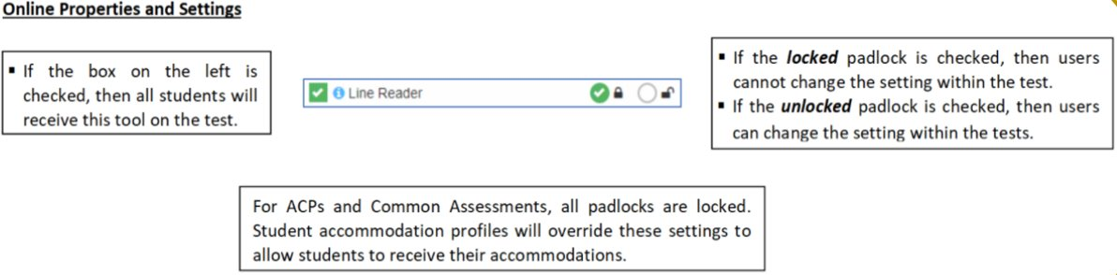
Online Properties and Settings
Notes:
Read slide as is

Slide 43
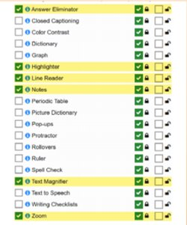
DAN Online Tools
The online tools highlighted in yellow are activated by the Assessment department and are accessible on all ACPs.
Social Studies, Science
Reading, Math
These tools are locked and cannot be altered. Note, the check mark next to the padlock.
Notes:
Read slide as is

Slide 44
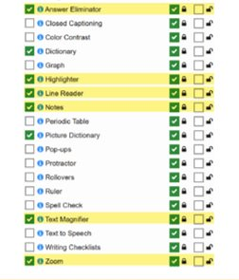
DAN Online Tools for Reading
Additional tools specific to the Reading/Spanish Reading/ESL ACP include:
Dictionary
Picture Dictionary
DAN does not have an embedded Spanish dictionary. A paper dictionary will need to be provided for students that need one.
Notes:
Read and review slide as is

Slide 45
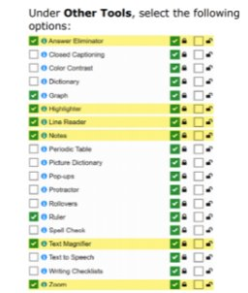
DAN Online Tools for Mathematics
Additional online tools specific to the Math ACP include:
Graph
Ruler
No calculator for grades 3-6 Math Honors
Advanced Calculator:
Grade 7 Math Honors
Grade 8 Math
Algebra I, Geometry, Algebra II, Pre-Calculus
Included resources:
Grade 3-8 Math, Algebra I use the appropriate STAAR formula chart
Geometry, Pre-Calculus, Algebra II use the appropriate ACP formula chart
Notes:
Read and review slide as is

Slide 46
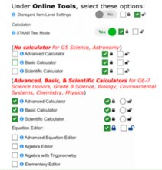
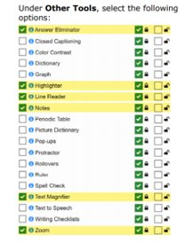
DAN Online Tools for Science
No calculator for Grade 5 Science, Astronomy
Advanced, Basic, & Scientific Calculators:
Grade 6-8 Science
Biology
Environmental Systems
Chemistry
Physics
No formula chart for Grade 5 & Biology
Included resource:
Grade 7 Science Honors & Grade 8 Science use Grade 8 STAAR formula chart
Notes:
Read and review slide as is

Slide 47

ACP
Paper Testing

Slide 48
ACP Paper Testing
Item | Details | Purpose | Extra Copies | Recycling
Test booklets for student testing (SECURE) | Consumable Color-coded B&W print only Large-print by request | Use to administer the test questions and answer choices to students. | Request using the ACP Online Ordering Form. (Subject to approval based on verified student eligibility.) | Test Coordinators must hand-deliver to the Service Center I after testing has completed.
Test booklets for ACP viewing (SECURE) | Non-consumable Color-coded B&W print only Optional for teacher review as scheduled by Test Coordinators Requires monitored sessions scheduled by Test Coordinators | Teachers can review the ACP content used for TEI calculations. A printed teacher survey is the only allowable item | Not available A minimum number of tests will be sent for each subject | Test Coordinators must hand-deliver to the Service Center I after testing has completed
Test survey sheets for ACP viewing (SECURE) | Consumable Pre-printed Orange color Scanned by Assessment | Use with test booklets assigned for ACP viewing | Not available For teachers-of-record only | Return with secure test booklets in a separate envelope with a local delivery ticket
Test Administrator scripts (NONSECURE) | Consumable Color-coded | Test Administrators will read the test directions verbatim to the students | Download from the Assessment website | Return with test booklets or recycle locally
Book numbering labels (NONSECURE) | Consumable Pre-printed | Test Coordinators will attach the labels to the test booklet covers. Test Administrators record the booklet number on the seating charts | Blanks will be provided | Return with test booklets or recycle locally
Paper tests will only be provided to Special Services students. Eligibility is based on documentation within a student’s IEP in the systems designated by the district.
The Assessment Department will ship the paper materials listed in the table to campuses.
Notes:
Read and review slide as is

Slide 49
ACP Preparing for Paper Testing
Inventory and secure paper materials when they arrive to your campus.
ACP Paper Allocations were confirmed by all campuses in October.
Additional testing materials may be ordered through the ACP Additional Order Form Link.
Verify your schoolwide access for DAN and campus-wide access for PowerSchool.
Verify that all teachers of record verify their rosters for paper testers.
Ensure that students who are eligible for paper tests are assigned a Test Administrator if there is a teacher vacancy.
Confirm that approved designated supports are updated in the appropriate systems by the deadlines.
Revisit DAN training modules for how to print answer sheets and system demos.
Double-check that transfer students have documentation to take paper tests.

Slide 50
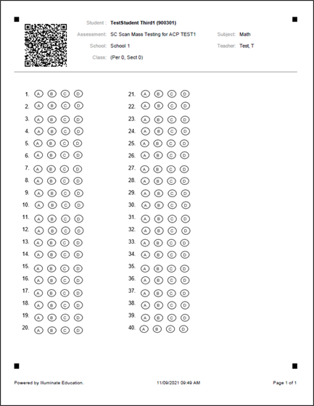
ACP Paper Testing – Answer Sheets
Use only No. 2 pencils.
Check that students bubble their answers on the answer sheets!
Answer sheet responses will be scanned by the Assessment Department and must be dropped daily at the Assessment Service Center.
Notes:
Read and review slide as is
Remind test administrators they will need to turn in their books and answer sheets to the testing center. Answer sheets will not be scored on campus but will be taken to the service center for scoring

Slide 51
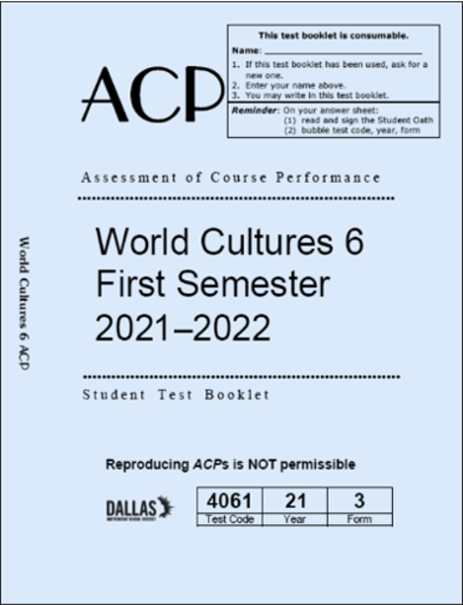
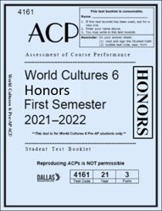
ACP Paper Testing – Test Booklets
Surrounded by a thick border
  Recognize the differences between regular and Honors ACP test covers.
Honors is marked on the edge
Notes:
It is important to know the differenc in regular books those for Honors classes.
Books for honors classes have a bold border
If you are administering a paper assesment be sure you have the correct book based on the student's enrolled class.
Mistakes can happen when preparing bins and buckets so if there is a question about which book you receive, contact TC immediately.

Slide 52
After
Testing

Slide 53
After Testing Test Administrators
Test Administrator Check-in
Scoring
Update the seating charts based on attendance and start/stop times.
If administering paper tests, count your answer sheets and test booklets separately.
Collect scratch paper and supplemental aids.
Check in all testing materials that were signed out.
Resolve discrepancies for missing test materials.
Conduct a final audit to ensure that all testing materials, paper-based tests, and supplemental aids are returned to your Test Coordinator.
Daily, ensure that you have submitted testing irregularity documentation prior to leaving.
Submit signed statements for testing irregularities to your Test Coordinator.
Follow up and ensure that all your students have test scores if you teach a course assessed via ACPs.
Review the make-up testing schedule.
Manually enter ACP scores into the PowerSchool grade book.
Make-up Testing
Follow up and assist with the campus decision for entering test scores past the deadline.
Notes:
Read and review slide as is

Slide 54
ACP Surveys for Teachers
Precoded surveys are shipped along with your testing materials. The purpose of the surveys is to document important teacher feedback about the tests. Participation is optional for teachers.
Test Coordinators will schedule a time and place for teachers to complete the surveys and review an unused ACP to answer the questions. The review session must be actively monitored by the Test Coordinator. Review sessions cannot occur before or during student testing.
Review Period Tips
Materials Handling
Only teachers of record receiving TEIs are allowed to review ACPs for their course content.
Campus Instructional Coaches are not allowed to complete the teacher surveys and review the tests.
No discussions about the tests are allowed during or after the review.
Teachers cannot copy any information (questions, answers, graphics, etc.) from the ACP test booklets.
A meeting sign-in sheet is required and must be filed with the other training sign-in sheets.
No cell phones, notes, data, books, templates and any other printouts are allowed during the review.
ACPs are secure tests. Teachers are still under oath during the review.
The precoded surveys are printed in orange and will arrive with the answer sheets.
No electronic survey version is available online.
A materials control form must be used to track the ACPs checked out/in and filed with the sign-in sheet.
The scheduled review is based on the availability of the Test Coordinator and meeting locations.
Completed surveys must be turned in separately with answer sheets on scanning days or with make-up answer sheets.
Do not send completed surveys by district mail or with the nonscorables.
Notes:
Read and review slide
Make sure to communicate your campus procedure for teachers to review an unused ACP to complete ACP survey.
Remind teachers this will be done in a secure and monitored setting.

Slide 55
Make-up Testing
Students have ten school days after the last day of the testing window to take a make-up test. The fall make-ups will be administered at each campus from January 5-19, 2022.
Make-up test scores are not uploaded to PowerSchool. Teachers of Record are responsible for updating PowerSchool. Make-up test scores must also be entered manually at the schools.
Testing accommodations must be administered during make-ups.
Students with excused absences can test by appointment after January 19, 2022. Students with unexcused absences who do not test during the make-up will receive an exam grade of zero
The retesting policy for ACP make-ups is located at: https://pol.tasb.org/Policy/Code/361?filter=EIA
Notes:
Dicusss makeup window and campus dates.

Slide 56

Test Security

Slide 57
Test Security Policy
DISD EK (Regulation): Testing (http://pol.tasb.org/Policy/Code/361?ﬁlter=EK)
ACPs comply with the standards and procedures outlined in the district Test Security Manual. The expectations for professional honesty and integrity apply to ACPs.
Test Coordinators must oversee and keep online and paper testing materials secure at all times. Test Administrators are responsible for maintaining the security of test materials in their possession and administering the correct test and accommodations to students.
Notes:
Read and review slide as is.
Remind test administrators all irregularities must be reported immediately to test coordinator along with a statement of the events that occurred.

Slide 58
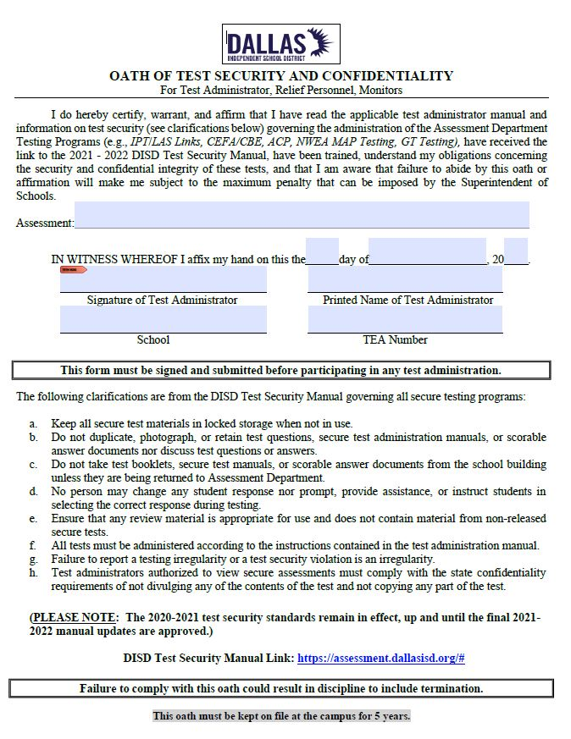
Test Security Oaths
The District requires that all personnel involved in testing are trained and sign a security oath before handling secure testing materials or participating in the administration of ACP test.
District Testing Oaths – Test Administrator Oath
Districts are required to retain signed security oaths, seating charts, testing irregularity and investigation documentation, and inventory and shipping records for five years following a test administration.
An oath must be signed by the Test Administrator for each assessment administration.
Notes:
Read slide as is
Be sure all involved with ACP test have completed the district test administrator oath

Slide 59
Test Security Addressing Irregularities
Irregularities for ACPs are handled locally within the district. Test Coordinators must adhere to all testing policies and procedures. Understanding the testing protocols and campus testing plans will deter serious testing irregularities.
This includes formally documenting and submitting irregularities reported for procedural and serious irregularities using the Testing Irregularity Security Violation (TISV) online form. Test administrators will need to submit signed, written statements to the TC should an irregularity occur.
Note: Testing irregularities must be addressed no later than 24 hours of the incident. If an irregularity is discovered after the date of an incident, then Test Coordinators must report it immediately. The district Test Security Manual provides additional guidance for collecting signed statements, how to approach students and securing evidence involved with student cheating.
Serious irregularities and incidents with campus-wide impacts may be handled directly by the District Test Security Officer and Professional Standards Office Department.
Notes:
Read slide as is

Slide 60
Test Security Serious and Procedural Irregularities
Serious
Procedural
Directly or indirectly assisting students.
Anyone tampering with student responses.
Discussing secure test content, student responses, or student performance.
Duplicating or electronically capturing any confidential student test content.
Failing to report an individual engaged in any violation of test security.
Viewing secure test content before, during, or after an administration without authorization.
Improper accounting of secure materials.
Not verifying that student responses are recorded on an answer sheet.
Leaving classrooms unattended.
Students were not prevented from using electronic devices and shared test content.
Students were permitted to test beyond the allowed time.
Students were not permitted to test during the allowable timeframe.
Test administrators did not read verbatim from the ACP script.
Test administrator using cell phone during testing.
Notes:
Read slide as is

Slide 61
Test Security Reporting Irregularities
Determine if the irregularity is serious or procedural.
For procedural, contact Assessment Department @ 972-925-8940 for guidance.
For serious, contact Charlenta Govan immediately for guidance.
Inform your campus principal about all irregularities.
Collect typed, signed statements from all parties involved including a statement from the testing coordinator.
Scan all documents to a file created by testing coordinator.
Create an incident report via the online TISV, Testing Irregularity/Security Violation Reporting Form. http://scbpaswmsas01/TISV/
Be sure to upload all required files to the TISV form.
Notes:
Read slide as is

Slide 62
Test Security Reminders
ACPs are secure tests.
Teachers of record will not test their own students.
Elementary teachers cannot administer tests within their grade level.
Secondary teachers cannot test within their content areas.
Campus instructional coaches cannot serve as Test Administrators or assistants within their content areas.
If students are administered the incorrect test, a testing irregularity must be reported.
Test Administrators must maintain a 1:35 ratio when testing grades 3-12 students.
Seating charts must be filled out completely and collected on each testing day.
Remove or cover maps, pictures, posters, graphics, or any other instructional tools that give tips, clues, or formulas to answer test questions.
No electronic devices can be used during ACPs. This includes cell phones, smart watches, wireless devices, and unapproved electronic versions of dictionaries and calculators.
ACPs content cannot be viewed in advance, copied, physically altered, or shared with a nearby school. This includes using the test cover as a template for a teacher-made test cover.
***Staff Members SHOULD NOT be on electronic devices as well!***
Notes:
Read slide as is
Be sure to communicate campus procedure for switching teachers

Slide 63
**Every class must submit a seating chart for each ACP test session. Failure to complete ALL portions of the seating chart is considered an irregularity.
Test Security Seating Charts
Seating charts must include the
following information:
Test administrator
seating chart reminders:
Campus name, TEA #
Room number, date
Complete name of test administrator(s) and signatures
Test taken subject area, grade level (if required)
Testing start and stop time(s) including lunch times, if applicable
Complete name of each student testing, student ID number
Booklet number and form number, as applicable
Complete name of relief personnel
Complete ALL parts of the seating chart.
The top heading of each page MUST be completely filled out.
Complete ALL student columns.
Complete the blank table.
Only include students who will actually test in your classroom.
Make sure to include start and stop times.
Notes:
Read slide as is
It is recommended to show example of DISD seating chart

Slide 64
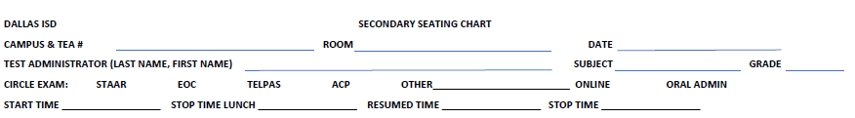
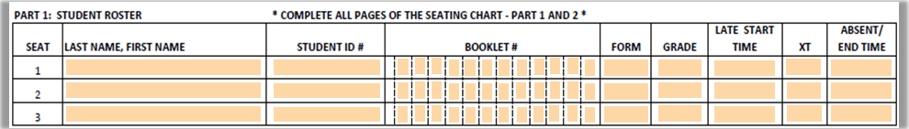
**Note to TC: You may want to give a printed copy of the seating chart as a training handout to review with your test administrators.
Test Security Seating Charts
Fill in all the categories for the campus and testing information.
Complete all categories for student information.
Failure to complete ALL portions of the seating chart is considered an irregularity.

Slide 65
**Note to TC: You may want to give a printed copy of the seating chart as a training handout to review with your test administrators.
Test Security Seating Charts
  Provide seating charts daily for all testing rooms.
  Include start and stop times for the test session.
  Include the test administrator’s first name and last name along with relief monitors.
  Only include students who will test in each site.
  Include a diagram of the testing room arrangement.
  It is not required to post seating charts.
  Seating charts should be filed on campus with retention documents.
Online General Seating Chart 2-page: Blank | Fillable
Paper General Seating Chart 2-page: Blank | Fillable
Failure to complete ALL portions of the seating chart is considered an irregularity.

Slide 66
Know
your responsibilities
Directions for online testing begin on page 38 of the manual.
Directions for paper testing begin on page 48 of the manual.
It is important to read your directions in advance.
Remember…
This training does not take the place of reading the manual.
There is no substitute for reading the manual.

Slide 67
Questions?
THANKS

